Slide 1
Introduction to PostGIS
shortened version of
http://postgis.net/workshops/postgis-intro
(some slides ommitted, no slides changed)
Attribute and License: see link

Slide 2
Section 2 - Introduction
Section 2 - Introduction

Slide 3
What is a spatial database?
Section 2 - Introduction
System for storage and random access of relationally (tables of rows and columns) structured data, providing the following capabilities for that data.
Data Types including Spatial Types
number, date, string, geometry, geography and raster
Indexes including Spatial Indexes
b-tree, hash, rtree, quadtree
Functions including Spatial Functions
strlen(string), pow(float, float), now(), ST_Area(), ST_Distance()

Slide 4
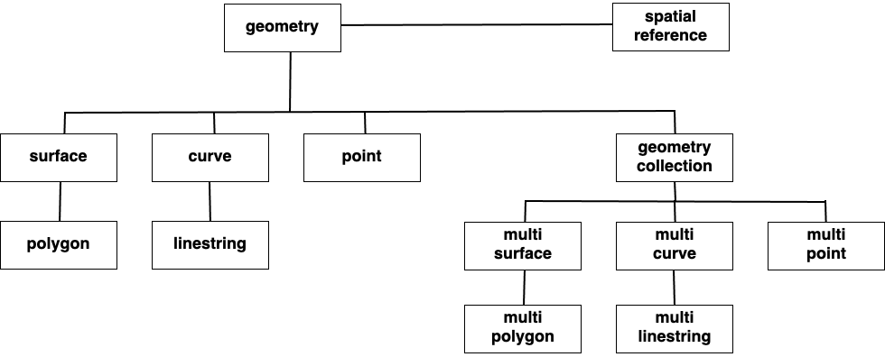
Spatial Types
Section 2 - Introduction

Slide 5
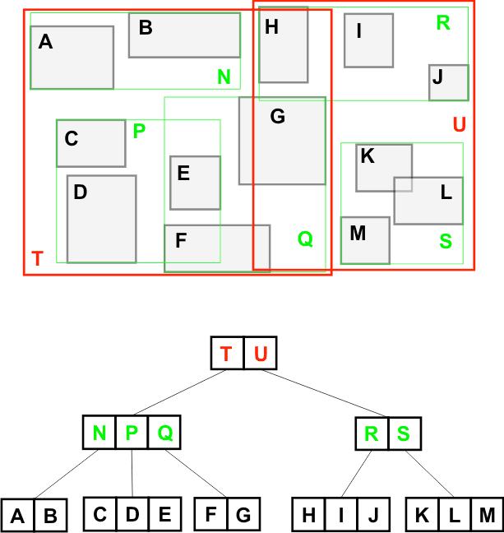
Spatial Indexes
Section 2 - Introduction
This R-Tree organizes the spatial objects so that a spatial search is a quick walk through the tree.
To find what object contains ?
The system first checks if it is in T or U (T)
Then it checks if it is in N, P or Q (P)
Then it checks if it is in C, D or E (D)
Only 8 boxes have to be tested. A full table scan would require all 13 boxes to be tested. The larger the table, the more powerful the index is.

Slide 6
Spatial Functions
Section 2 - Introduction
For example:
ST_GeometryType(geometry) → text
ST_Area(geometry) → float
ST_Distance(geometry, geometry) → float
ST_Buffer(geometry, radius) → geometry
ST_Intersection(geometry, geometry) → geometry
ST_Union([geometry]) → geometry
Notes:
Functions: manipulate data during a query,
an ordinary database concatenates strings, performs hash operations on strings, does MATH on numbers, and extracts information from dates. A spatial database provides a complete set of functions for analyzing geometric components, determining spatial relationships, and manipulating geometries.

Slide 7




What is PostGIS?
Section 2 - Introduction
CREATE EXTENSION
postgis;
Notes:
What people call “PostGIS” is actually just a combination of the PostgreSQL relational database, which provides all the standard database features (standard types, functions, indexes) and the PostGIS “extension” to PostgreSQL which adds in the spatial types, spatial functions and spatial indexes. So any software that “works with PostGIS” works with PostgreSQL, and vice versa.

Slide 8
Section 9 - Geometries
Section 9 - Geometries

Slide 9
Creating a table with geometry
Section 9 - Geometries
CREATE TABLE geometries
(
name varchar,
geom geometry
);
Notes:
In pgAdmin,
Select the nyc database
Open the SQL query tool.
Paste the example SQL code into the pgAdmin SQL Editor window (removing any text that may be there by default) and then
Execute.

Slide 10
Creating a table with geometry
Section 9 - Geometries
INSERT INTO geometries (name, geom) VALUES
('Point', 'POINT(0 0)'),
('Linestring', 'LINESTRING(0 0, 1 1, 2 1, 2 2)'),
('Polygon', 'POLYGON((0 0, 1 0, 1 1, 0 1, 0 0))'),
('PolygonWithHole', 'POLYGON((...))'),
('Collection', 'GEOMETRYCOLLECTION(...)');
Notes:
The above example CREATEs a table (geometries) then
INSERTs five geometries: a point, a line, a polygon, a polygon with a hole, and a collection.

Slide 11
Creating a table with geometry
Section 9 - Geometries
SELECT name, ST_AsText(geom)
FROM geometries;

Slide 12
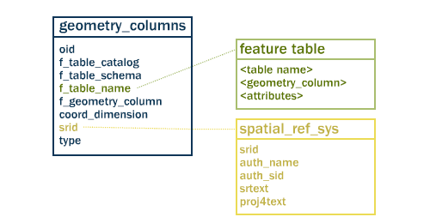
Table Relationships
Section 9 - Geometries
Notes:
two tables to track and report on the geometry types available in a given database.
spatial_ref_sys, defines all the spatial reference systems known to the database
geometry_columns, provides a listing and basic details of all “features”

Slide 13
geometry_columns
Section 9 - Geometries
SELECT * FROM geometry_columns
Notes:
By querying this table, GIS clients and libraries can determine what to expect when retrieving data
and can perform any necessary projection, processing or rendering without needing to inspect each geometry.

Slide 14
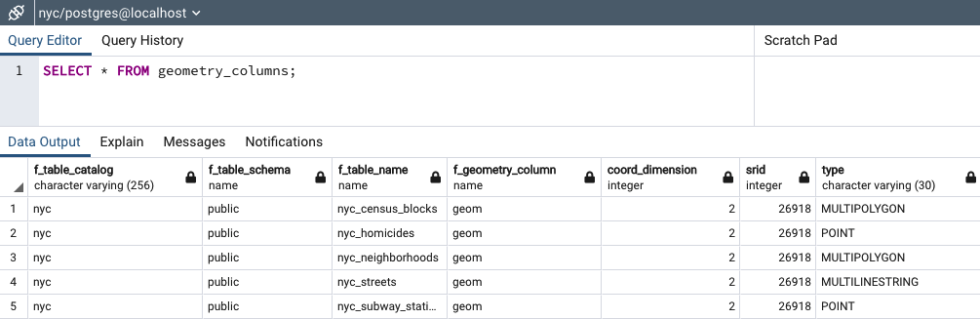
geometry_columns
Section 9 - Geometries
Notes:
f_table_name: fully qualified name of the feature table
f_geometry_column: name of the column that geometry containing column
– for feature tables with multiple geometry columns, there will be one record for each.
coord_dimension : 2-, 3- or 4-dimensional
srid: Spatial Reference system identifier
type: defines the type of geometry e.g., Point and Linestring

Slide 15
Metadata functions
Section 9 - Geometries
SELECT
name,
ST_GeometryType(geom),
ST_NDims(geom),
ST_SRID(geom)
FROM geometries;
Notes:
Our example table contains a mixture of different geometry types.
We can collect general information about each object using functions that read the geometry metadata.
GeometryType, NDims, SRID

Slide 16
Metadata functions
Section 9 - Geometries
name | st_geometrytype | st_ndims | st_srid
-----------------+-----------------------+----------+---------
Point | ST_Point | 2 | 0
Linestring | ST_LineString | 2 | 0
Polygon | ST_Polygon | 2 | 0
PolygonWithHole | ST_Polygon | 2 | 0
Collection | ST_GeometryCollection | 2 | 0
Notes:
ST_GeometryType(geometry) returns the type of the geometry
ST_NDims(geometry) returns the number of dimensions of the geometry
ST_SRID(geometry) returns the spatial reference identifier number of the geometry

Slide 17
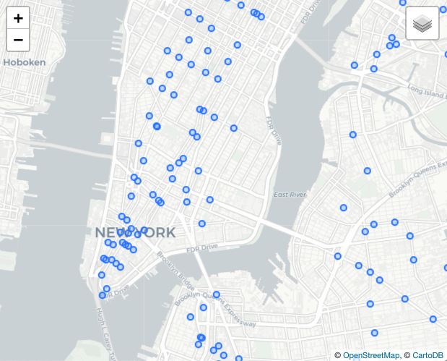
Points
Section 9 - Geometries
“Point” or “MultiPoint”, representing one or more 0-dimensional locations.
New York city subway stations, stop signs, man holes, address points, current locations of vehicles, might all use a “Point” geometry type.

Slide 18
Points
Section 9 - Geometries
SELECT ST_AsText(geom)
FROM geometries
WHERE name = 'Point'; POINT(0 0)
Notes:
Our example table contains a mixture of different geometry types.
We can collect general information about each object using functions that read the geometry metadata.
GeometryType, NDims, SRID

Slide 19
Points
Section 9 - Geometries
SELECT
ST_X(geom),
ST_Y(geom)
FROM geometries
WHERE name = 'Point' 0 0
Notes:
Our example table contains a mixture of different geometry types.
We can collect general information about each object using functions that read the geometry metadata.
GeometryType, NDims, SRID

Slide 20
Points
Section 9 - Geometries
SELECT
name,
ST_AsText(geom)
FROM nyc_subway_stations
LIMIT 1; Cortlandt St | POINT(583521 4507077)
Notes:
Our example table contains a mixture of different geometry types.
We can collect general information about each object using functions that read the geometry metadata.
GeometryType, NDims, SRID

Slide 21
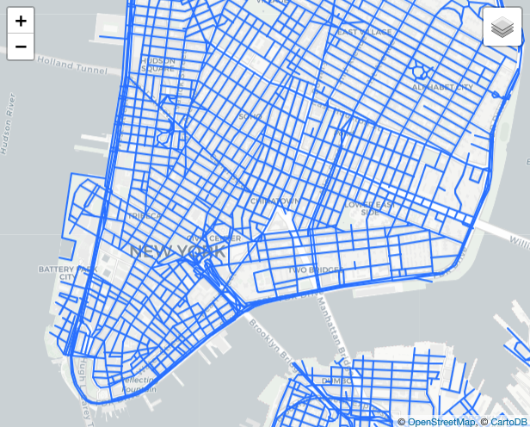
LineStrings
Section 9 - Geometries
“LineString” or “MultiLineString”, representing one or more 1-dimensional objects.
Streets, streams, bus routes, power lines, driven routes, highways, might all use a “LineString” geometry type.

Slide 22
LineStrings
Section 9 - Geometries
SELECT ST_AsText(geom)
FROM geometries
WHERE name = 'Linestring'; LINESTRING(0 0,1 1,2 1,2 2)
Notes:
Our example table contains a mixture of different geometry types.
We can collect general information about each object using functions that read the geometry metadata.
GeometryType, NDims, SRID

Slide 23
LineStrings
Section 9 - Geometries
SELECT ST_Length(geom)
FROM geometries
WHERE name = 'Linestring';
3.41421356237309
Notes:
Our example table contains a mixture of different geometry types.
We can collect general information about each object using functions that read the geometry metadata.
GeometryType, NDims, SRID

Slide 24
LineStrings
Section 9 - Geometries
ST_Length(linestring)
ST_StartPoint(linestring)
ST_EndPoint(linestring)
ST_NumPoints(linestring)

Slide 25
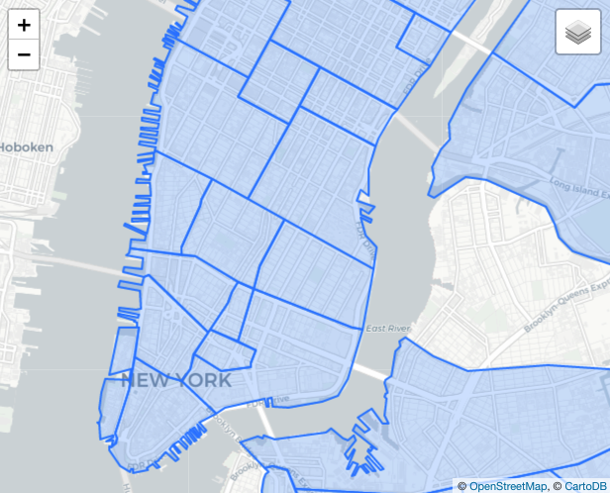


Polygons
Section 9 - Geometries
“Polygon” or “MultiPolygon”, representing one or more 2-dimensional objects.
Census areas, parcels, counties, countries, neighborhoods, zoning areas, watersheds, and more.

Slide 26
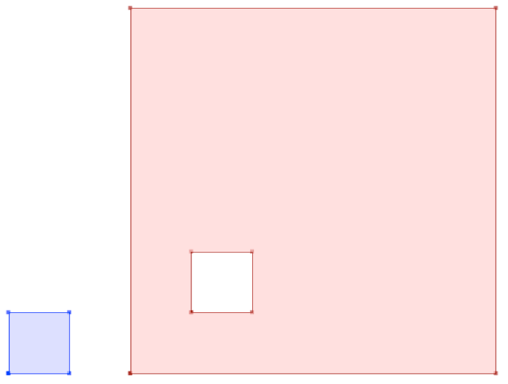
Polygons
Section 9 - Geometries
Notes:
The first polygon has only one ring.
The second one has an interior “hole”.
Most graphics systems include the concept of a “polygon”,
but GIS systems are relatively unique in allowing polygons to explicitly have holes.

Slide 27
Polygons
Section 9 - Geometries
SELECT ST_AsText(geom)
FROM geometries
WHERE name LIKE 'Polygon%';
POLYGON((0 0, 1 0, 1 1, 0 1, 0 0))
POLYGON((0 0, 10 0, 10 10, 0 10, 0 0), (1 1, 1 2, 2 2, 2 1, 1 1))
Notes:
Rather than using an = sign in our WHERE clause,
we are using the LIKE operator to carry out a string matching operation.

Slide 28
Polygons
Section 9 - Geometries
ST_Area(polygon)
ST_NumInteriorRings(polygon)
ST_ExteriorRing(polygon)
ST_InteriorRing(polygon,n)
ST_Perimeter(polygon)
Notes:
ST_Area(geometry) returns the area of the polygons
ST_NumInteriorRings(geometry) returns the number of interior rings (usually 0, more of there are holes)
ST_ExteriorRing(geometry) returns the outer ring as a linestring
ST_InteriorRingN(geometry,n) returns a specified interior ring as a linestring
ST_Perimeter(geometry) returns the length of all the rings

Slide 29
Polygons
Section 9 - Geometries
SELECT name, ST_Area(geom)
FROM geometries
WHERE name LIKE 'Polygon%';
Polygon | 1
PolygonWithHole | 99
Notes:
Calculate the area of our polygons using the area function
Note that the polygon with a hole has an area that is the area of the outer shell
(a 10x10 square) minus the area of the hole (a 1x1 square).

Slide 30
Geometry Formats
Section 9 - Geometries
ST_As...
Text, EWKT, GML, KML, SVG, GeoJSON, Binary, EWKB
ST_GeomFrom...
Text, EWKT, GML, KML, GeoJSON, Binary, EWKB
Notes:
Geometries are stored on disk in a format only used by PostGIS.
External programs to insert and retrieve useful geometries, they need to be converted into a format that other applications can understand.
PostGIS supports emitting and consuming geometries in a large number of formats:
These are called Geometry Constructors
WKT: Well-known text Can refer either to the text representation of geometries, with strings starting “POINT”, “LINESTRING”, “POLYGON”, etc. Or can refer to the text representation of a CRS, with strings starting “PROJCS”, “GEOGCS”, etc. Well-known text representations are OGC standards, but do not have their own specification documents. The first descriptions of WKT (for geometries and for CRS) appeared in the SFSQL 1.0 specification.
WKB: Well-known binary Refers to the binary representation of geometries described in the Simple Features for SQL specification (SFSQL).
GML: Geography Markup Language. GML is the OGC standard XML grammar for expressing geographical features. GML serves as a modeling language for geographic systems as well as an open interchange format for geographic transactions on the Internet. As with most XML based grammars, there are two parts to the grammar – the schema that describes the document and the instance document that contains the actual data.
JSON: Javascript Object Notation a text format that is very fast to parse in Javascript virtual machines. In spatial, the extended specification for GeoJSON is commonly used.
GeoJSON: A format for encoding a variety of geographic data structures. A GeoJSON object may represent a geometry, a feature, or a collection of features. GeoJSON supports the following geometry types: Point, LineString, Polygon, MultiPoint, MultiLineString, MultiPolygon, and GeometryCollection. Features in GeoJSON contain a geometry object and additional properties, and a feature collection represents a list of features.
KML: Keyhole Markup Language the spatial XML format used by Google Earth. Google Earth was originally written by a company named “Keyhole”, hence the (now obscure) reference in the name.

Slide 31
Geometry Formats
Section 9 - Geometries
SELECT ST_AsText(
ST_GeometryFromText(
'LINESTRING(0 0 0,1 0 0,1 1 2)'
)
);
LINESTRING Z (0 0 0,1 0 0,1 1 2)
Notes:
Extended Well-known Text Representation. This format embeds the SRID to the geometry.
3- or 4-dimensional geometries

Slide 32
Geometry Formats
Section 9 - Geometries
SELECT ST_AsGeoJSON(
ST_GeomFromGML(
'<gml:Point>
<gml:coordinates>
1,1
</gml:coordinates>
</gml:Point>'
));
{"type":"Point","coordinates":[1,1]}

Slide 33
All roads lead to Rome … (Geometry construction)
Section 9 - Geometries
SELECT ST_AsEWKT(
ST_GeomFromText('POINT(1 1)', 4326)
);
SRID=4326;POINT(1 1)
Notes:
There are many many ways to create a geometry from a pair of coordinates.
In general, you need to provide both the coordinate information and the SRID, so the system can correctly locate the geometry on the earth.
This example uses the ST_GeomFromText() constructor.

Slide 34
All roads lead to Rome … (Geometry construction)
Section 9 - Geometries
SELECT ST_AsEWKT(
ST_SetSRID(
ST_GeomFromText('POINT(1 1)'),
4326
)
);
SRID=4326;POINT(1 1)
Notes:
There is also a one-parameter ST_GeomFromText() function, that sets the SRID to 0. So then we wrap it in an ST_SetSRID() function to supply the SRID afterwards.

Slide 35
All roads lead to Rome … (Geometry construction)
Section 9 - Geometries
SELECT ST_AsEWKT(
ST_SetSRID(
ST_MakePoint(1, 1),
4326
)
);
SRID=4326;POINT(1 1)
Notes:
Sometimes it is nice to avoid the overhead of parsing text, particularly if you are just creating a point.The ST_MakePoint() function, with the ST_SetSRID() function can generate a new point without parsing text inputs. Building a POINT with string concatenation and then parsing it is a potential SQL injection vector.

Slide 36
All roads lead to Rome … (Geometry construction)
Section 9 - Geometries
SELECT ST_AsEWKT(
ST_SetSRID(
'POINT(1 1)'::geometry,
4326
)
);
SRID=4326;POINT(1 1)
Notes:
PostgreSQL has a type casting notation, the “::” operator that applies the desired cast, in this case from a text string directly to a geometry. As long as the text is a valid WKT or HEXWKB string, casting directly from text works automatically. There’s no SRID in the text, so we have to add it after using ST_SetSRID().

Slide 37
All roads lead to Rome … (Geometry construction)
Section 9 - Geometries
SELECT ST_AsEWKT(
'SRID=4326;POINT(1 1)'::geometry
);
SRID=4326;POINT(1 1)
Notes:
The “extended well-known-text” format includes a slot for the SRID, so you can go from text to a geometry-with-SRID in one step, casting from EWKT to geometry.

Slide 38
Section 11 - Spatial Relationships
Section 11 - Spatial Relationships

Slide 39
Spatial Relationship Functions
Section 11 - Spatial Relationships
ST_Intersects(A, B)
ST_DWithin(A, B, d)
ST_Distance(A, B)
ST_Within, ST_Contains(A, B)
ST_Equals(A, B)
ST_Touches(A, B)
ST_Disjoint, ST_Crosses, ST_Overlaps(A, B)
Common
Uncommon

Slide 40
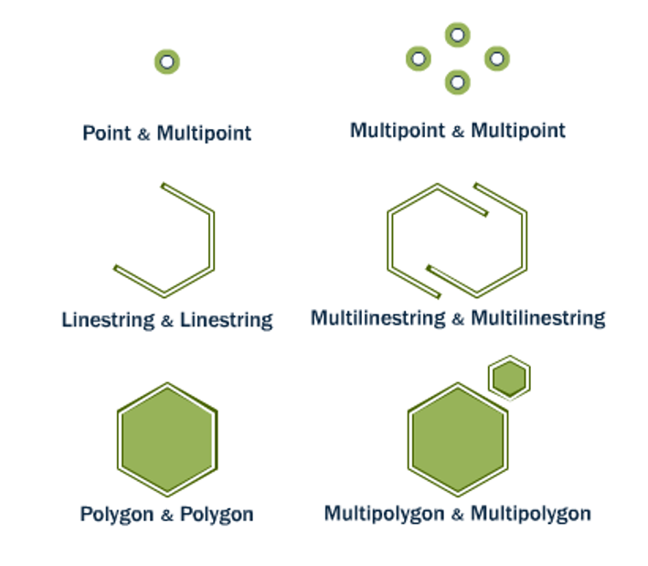
ST_Equals(A, B) ST_OrderingEquals(A, B)
Section 11 - Spatial Relationships
Equals tests that A and B cover the same space, regardless of representation differences (extra vertices, order of vertices). OrderingEquals insists on structural identity.
Notes:
Looking for exact matches is actually relatively rare in geospatial (it’s more common to look for “nearby” or “interacting” things), but when you need to search, the equal and equals exact functions are there. Exact structural equality can be important searching for directed roads in a network, where direction of digitization is meaningful. Equality without exact representation is useful for finding things like polygons, where the order of rings and start/end of rings isn’t important, but the area of coverage is.

Slide 41
What is geometry of Broad Street subway station?
Section 11 - Spatial Relationships
SELECT name, geom
FROM nyc_subway_stations
WHERE name = 'Broad St';
0101000020266900000EEBD4CF27CF2141BC17D69516315141

Slide 42
What subway station record matches that geometry?
Section 11 - Spatial Relationships
SELECT name
FROM nyc_subway_stations
WHERE ST_Equals(
geom, '0101000020266900000EEBD4CF27CF2141BC17D69516315141' );
Broad St

Slide 43
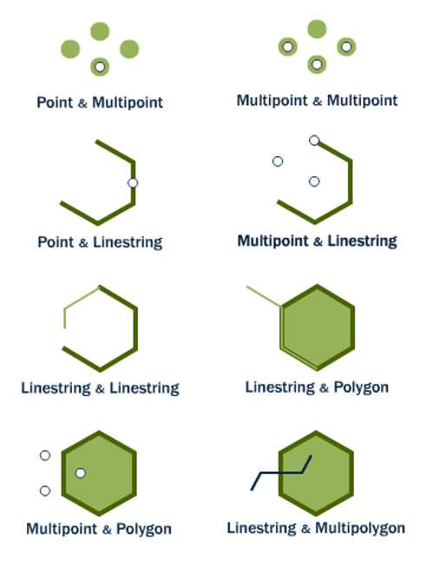
ST_Intersects(A, B) ST_Disjoint(A, B)
Section 11 - Spatial Relationships
Intersects and disjoint are opposites. Any kind of interactions between two shapes is an intersection, and implies the pair are not disjoint, and vice versa.
A intersects B ⇒ A not disjoint B
A disjoint B ⇒ A not intersects B
Notes:
The most widely used “spatial predicate” (spatial relationship with a boolean return value), intersects is for queries looking for “any objects with interaction”. Objects that touch, overlap, contain or are contained, they all intersect. Objects with zero distance between each other intersect. Objects with greater than zero, are disjoint. Find all the customer locations that intersect the service area of this store. Find all the airplane tracks that intersect the forbidden flight zone. Find all the parcels that intersect the fire hall service zone.

Slide 44
What is the well-known text (WKT) of Broad Street subway station?
Section 11 - Spatial Relationships
SELECT name, ST_AsText(geom, 0)
FROM nyc_subway_stations
WHERE name = 'Broad St';
POINT(583571 4506714)

Slide 45
What neighborhood intersects that subway station?
Section 11 - Spatial Relationships
SELECT name, boroname
FROM nyc_neighborhoods
WHERE ST_Intersects(
geom, ST_GeomFromText( 'POINT(583571 4506714)', 26918));
Financial District | Manhattan

Slide 46
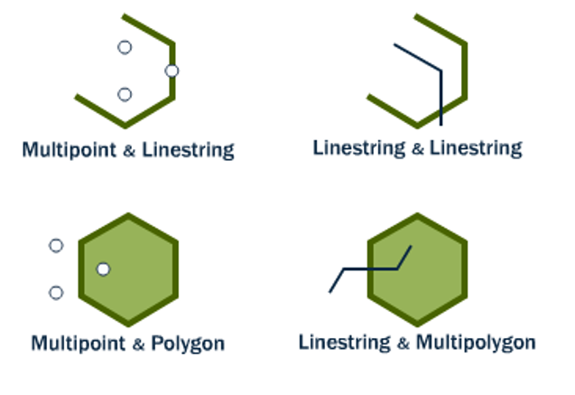
ST_Crosses(A, B)
Section 11 - Spatial Relationships
Mostly used to test linestrings, which can be said to cross when their interiors have interactions.
When linestrings cross polygon boundaries, the crosses condition is also true.
Notes:
Crosses is infrequently used because it mostly has intuitive sense for lines (though it is defined for all type combinations as shown in the diagram). In the case where lines cross at their mid-point, is an “un-noded” intersection between lines. Sometimes people are interested in un-noded crossings because they want to fix them (many road networks are expected to be “fully noded”. Sometimes people are interested in un-noded crossings for what they represent (some road networks use them to represent things like over- and under-passes).

Slide 47
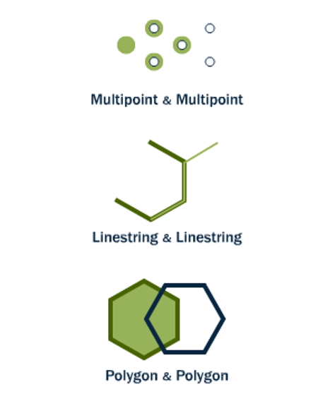
ST_Overlaps(A, B)
Section 11 - Spatial Relationships
Shapes overlap when their interiors interact with each other and also with the exterior of the shape.
So objects that are contained or within do not overlap, overlaps is what normal people might call “partial overlap”.
Notes:
Overlaps is probably the least used predicate. It’s quite specific, the objects share some of their interiors but neither shares all of it’s interior. People might understand it more as a “partial overlap”.

Slide 48
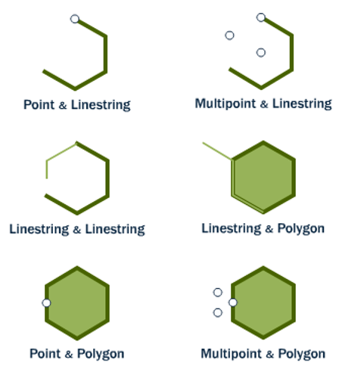
ST_Touches(A, B)
Section 11 - Spatial Relationships
Shapes touch when their boundaries interact but their interiors do not. End points for lines, exterior rings for polygons. Usually used for testing that polygons have ring-touching only.

Slide 49
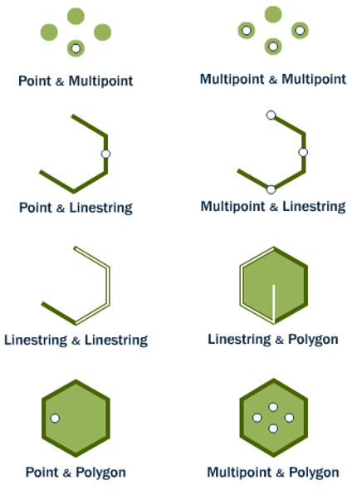
ST_Within(A, B) ST_Contains(B, A)
Section 11 - Spatial Relationships
Within and contains are about objects being fully inside. One important caveat, for both functions an object on the boundary is not considered within. So a point on the outer ring of a polygon is not within the polygon.

Slide 50
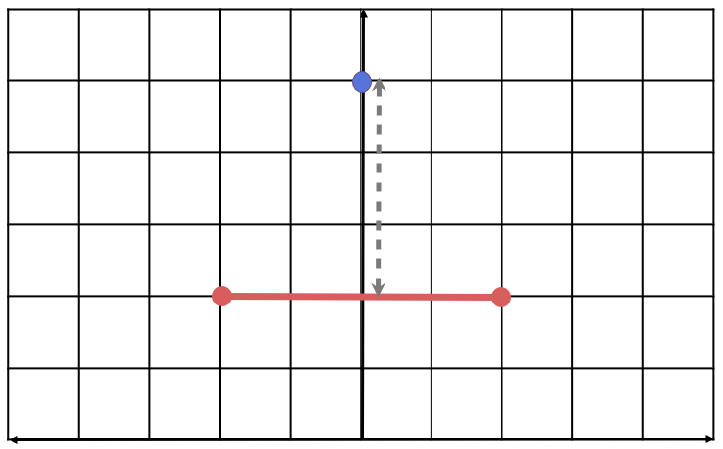
ST_Distance(A, B)
Section 11 - Spatial Relationships
Returns the shortest distance between the two geometries, in this case the distance from the point to the line mid-point.

Slide 51
ST_Distance(A, B)
Section 11 - Spatial Relationships
SELECT ST_Distance(
'POINT(0 5)'::geometry,
'LINESTRING(-2 2, 2 2)'::geometry );
3

Slide 52
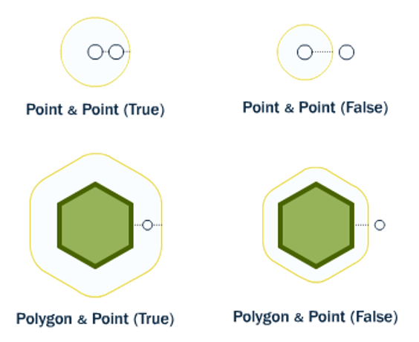
ST_DWithin(A, B, R)
Section 11 - Spatial Relationships
Index-enabled radius search function. True when the distance from geometry A to geometry B is less than radius R. False otherwise.
Use instead of ST_Distance(A, B) < R, in order to get benefit of spatial index.

Slide 53
What streets are within 10 meters of Broad Street subway station?
Section 11 - Spatial Relationships
SELECT name
FROM nyc_streets
WHERE ST_DWithin(
geom,
ST_GeomFromText('POINT(583571 4506714)',26918),
10
);

Slide 54
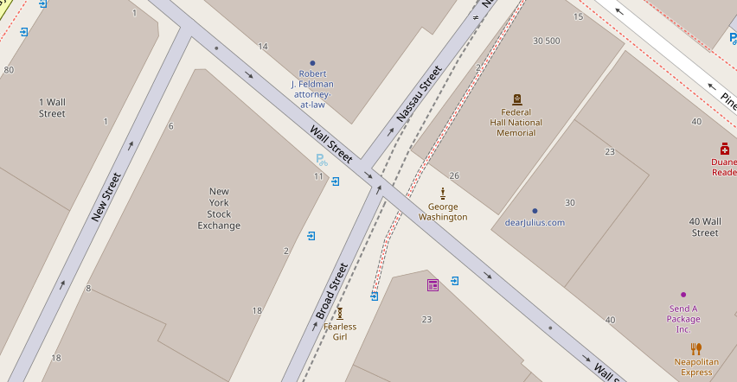

Section 11 - Spatial Relationships

Slide 55
Section 13 - Spatial Joins
Section 13 - Spatial Joins

Slide 56
Section 13 - Spatial Joins
What neighborhood is the 'Broad St' station in?

Slide 57
Remember...
Section 13 - Spatial Joins
SELECT name, boroname
FROM nyc_neighborhoods
WHERE
ST_Intersects(
geom,
ST_GeomFromText(
'POINT(583571 4506714)',
26918));
Notes:
In the previous section, we explored spatial relationships using a two-step process:
1. extract a subway station point for ‘Broad St’
2. use that point to ask further questions such as “what neighborhood is the ‘Broad St’ station in?”
Using a spatial join, we can answer the question in one step,
retrieving information about the subway station and the neighborhood that contains it:

Slide 58
Do it in one step, with a spatial join!
Section 13 - Spatial Joins
SELECT s.name, n.name, n.boroname
FROM nyc_neighborhoods AS n
JOIN nyc_subway_stations AS s
ON ST_Contains(
n.geom,
s.geom
)
WHERE s.name = 'Broad St';
Notes:
In the previous section, we explored spatial relationships using a two-step process:
1. extract a subway station point for ‘Broad St’
2. use that point to ask further questions such as “what neighborhood is the ‘Broad St’ station in?”
Using a spatial join, we can answer the question in one step,
retrieving information about the subway station and the neighborhood that contains it:

Slide 59
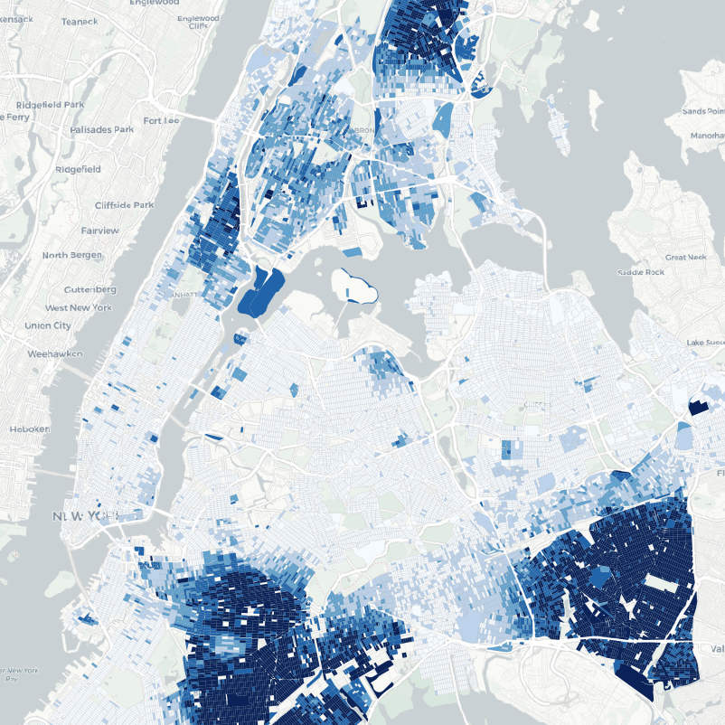
Section 13 - Spatial Joins
What is the population and racial make-up of the neighborhoods of Manhattan?
Notes:
The combination of a JOIN with a GROUP BY provides the kind of analysis that is usually done in a GIS system.
Here we have a question that combines information from about population from the census
with the boundaries of neighborhoods, with a restriction to just one borough of Manhattan.

Slide 60
Section 13 - Spatial Joins
SELECT n.name AS neighborhood_name,
SUM(c.popn_total) AS population,
100*SUM(c.popn_white)/SUM(c.popn_total) AS white_pct,
100*SUM(c.popn_black)/SUM(c.popn_total) AS black_pct
FROM nyc_neighborhoods AS n
JOIN nyc_census_blocks AS c
ON ST_Intersects(
n.geom,
c.geom
)
WHERE n.boroname = 'Manhattan'
GROUP BY n.name
ORDER BY white_pct DESC;

Slide 61
Section 13 - Spatial Joins
neighborhood_name | popn | white % | black %
---------------------+--------+---------+---------
Carnegie Hill | 18763 | 90.1 | 1.4
West Village | 26718 | 87.6 | 2.2
North Sutton Area | 22460 | 87.6 | 1.6
Upper East Side | 203741 | 85.0 | 2.7
Soho | 15436 | 84.6 | 2.2
Greenwich Village | 57224 | 82.0 | 2.4
Central Park | 46600 | 79.5 | 8.0
Tribeca | 20908 | 79.1 | 3.5
Gramercy | 104876 | 75.5 | 4.7
Murray Hill | 29655 | 75.0 | 2.5
Chelsea | 61340 | 74.8 | 6.4
Upper West Side | 214761 | 74.6 | 9.2
Midtown | 76840 | 72.6 | 5.2
Battery Park | 17153 | 71.8 | 3.4
neighborhood_name | popn | white % | black %
---------------------+--------+---------+---------
Financial District | 34807 | 69.9 | 3.8
Clinton | 32201 | 65.3 | 7.9
East Village | 82266 | 63.3 | 8.8
Garment District | 10539 | 55.2 | 7.1
Morningside Heights | 42844 | 52.7 | 19.4
Little Italy | 12568 | 49.0 | 1.8
Yorkville | 58450 | 35.6 | 29.7
Inwood | 50047 | 35.2 | 16.8
Washington Heights | 169013 | 34.9 | 16.8
Lower East Side | 96156 | 33.5 | 9.1
East Harlem | 60576 | 26.4 | 40.4
Hamilton Heights | 67432 | 23.9 | 35.8
Chinatown | 16209 | 15.2 | 3.8
Harlem | 134955 | 15.1 | 67.1

Slide 62
Section 13 - Spatial Joins
Let's explore the racial geography of New York City...
Notes:
...using distance queries

Slide 63
Overall Racial Make-up of NYC
Section 13 - Spatial Joins
SELECT
100.0*SUM(popn_white)/SUM(popn_total) AS white_pct,
100.0*SUM(popn_black)/SUM(popn_total) AS black_pct,
SUM(popn_total) AS popn_total
FROM nyc_census_blocks;
white_pct | black_pct | popn_total
-------------------+--------------------+------------
44.00395007628105 | 25.546578900241613 | 8175032
Notes:
Of the ~8M people in NYC, 44% are white and 26% are black.

Slide 64


Section 13 - Spatial Joins
You, must take the train.
To, go to Sugar Hill way up in Harlem.
Notes:
"Take the 'A' Train" - https://www.youtube.com/watch?v=cb2w2m1JmCY
As we saw earlier, Harlem has far and away the highest African-American population in Manhattan.
Is the same true of Duke’s A-train?

Slide 65
Section 13 - Spatial Joins
What is the racial make-up of the areas served by the train?

Slide 66
Section 13 - Spatial Joins
First, we must determine where the train stops.
Notes:
nyc_subway_stations table
routes field

Slide 67
Our routes are comma-separated strings!
Section 13 - Spatial Joins
SELECT DISTINCT routes
FROM nyc_subway_stations;
4,5
N,Q,R,W
J
B,M,Q,R
D,F,N,Q
J,M
E,F
...
Notes:
The values in there are a little complex.
NOTE: The DISTINCT keyword eliminates duplicate rows from the result.
Without the DISTINCT keyword, the query above identifies 491 results instead of 73.
(Note: there are nulls in the result set)

Slide 68
Postgres string function: strpos()
Section 13 - Spatial Joins
strpos(routes,'A') returns a non-zero number if 'A' is in the routes field
Check out https://www.postgresql.org/docs/current/functions-string.html
Notes:
We will want any row in routes that has an ‘A’ in it.
Can do this a number of ways**
strpos(routes,’A’) returns a non-zero number if ‘A’ is in the routes field.

Slide 69
Find all routes with an “A”
Section 13 - Spatial Joins
SELECT DISTINCT routes
FROM nyc_subway_stations AS subways
WHERE strpos(subways.routes,'A') > 0;
A,C
A,B,C,D
A,C,E,L
A,C,F
A,B,C
A,S
A,C,E
...
Notes:
The values in there are a little complex.
NOTE: The DISTINCT keyword eliminates duplicate rows from the result.
Without the DISTINCT keyword, the query above identifies 491 results instead of 73.
(Note: there are nulls in the result set)

Slide 70
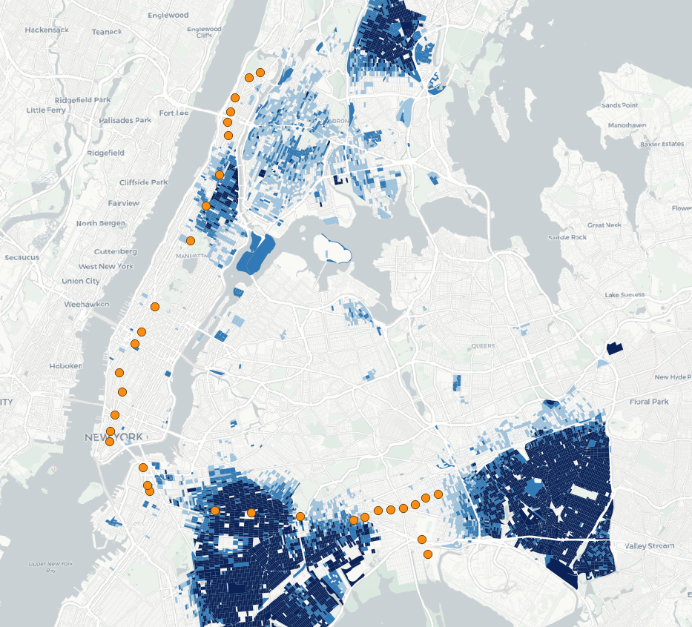
Section 13 - Spatial Joins
The route of the A train.
What is the racial makeup within 200 meters of each stop? Who is served by the A train?
Notes:
So finally. . back to the question:
What is the racial make-up of the areas served by the A train?

Slide 71
Summarize population 200m from A train stops
Section 13 - Spatial Joins
SELECT
100*SUM(c.popn_white)/SUM(c.popn_total) AS white_pct,
100*SUM(c.popn_black)/SUM(c.popn_total) AS black_pct,
SUM(popn_total) AS popn_total
FROM nyc_census_blocks AS c
JOIN nyc_subway_stations AS s
ON ST_DWithin(
c.geom,
s.geom,
200
)
WHERE strpos(s.routes,'A') > 0;

Slide 72
Section 13 - Spatial Joins
New York | Train
44.00% white | 45.59% white
25.55% black | 22.09% black
Notes:
The racial make-up along the A-train isn’t radically different from the make-up of New York City as a whole.
Recall of the 8M people in New York, about 44% are “white” and 26% are “black”.

Slide 73
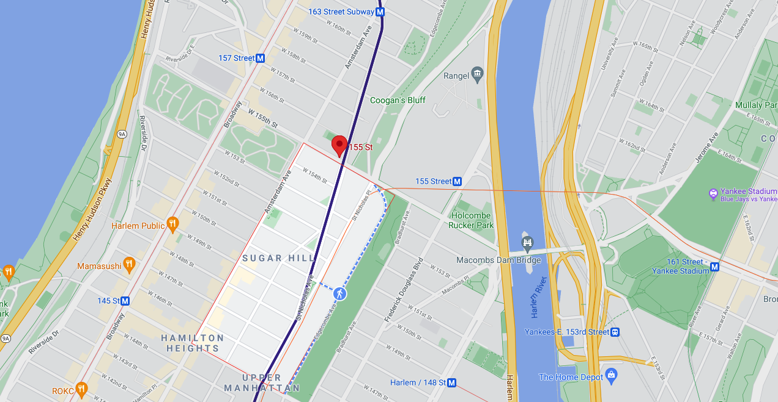
Section 13 - Spatial Joins
You, must take the train.
To, go to Sugar Hill way up in Harlem.

Slide 74
Section 15 - Spatial Indexing
Section 15 - Spatial Indexing

Slide 75
A spatial database has...
Section 15 - Spatial Indexing
Spatial Data Types
geometry, geography
Spatial Indexes
r-tree, quad-tree, kd-tree
Spatial Functions
ST_Length(geometry), ST_X(geometry)

Slide 76
A spatial index speeds spatial query ...
Section 15 - Spatial Indexing
Join two tables of 10,000 records each
Without Index | With Index
10,000 * 10,000 = 100,000,000 comparisons | 10,000 + 10,000 = 20,000 comparisons

Slide 77
To prove it… remove the index.
Run a spatial join.
Section 15 - Spatial Indexing
DROP INDEX nyc_census_blocks_geom_idx;
SELECT b.blkid
FROM nyc_census_blocks b
JOIN nyc_subway_stations s
ON ST_Contains(b.geom, s.geom)
WHERE s.name LIKE 'B%';
~300 ms

Slide 78
Create the index again.
Run the join again.
Section 15 - Spatial Indexing
CREATE INDEX nyc_census_blocks_geom_idx ON nyc_census_blocks USING GIST (geom);
SELECT blocks.blkid
FROM nyc_census_blocks b
JOIN nyc_subway_stations s
ON ST_Contains(b.geom, s.geom)
WHERE s.name LIKE 'B%';
~90 ms

Slide 79

Spatial Index Cliff Notes
Section 15 - Spatial Indexing
CREATE INDEX index_name ON table_name USING GIST (geom)
Use a “spatially indexed function” in JOIN or WHERE clause
ST_Intersects(A, B), ST_Contains(A, B), ST_Within(A, B)
ST_DWithin(A, B, R)

Slide 80

Spatial Index Internals
Section 15 - Spatial Indexing
Some spatial objects (like the star) are quite large and complex. Comparing complex objects is expensive!
Instead of indexing objects directly, spatial indexes work on the bounding boxes of the objects.
The boxes are of uniform size, and can be compared to determine spatial relationships very quickly.

Slide 81
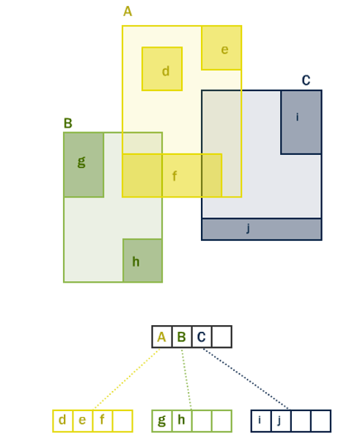
Section 15 - Spatial Indexing
The boxes can be arranged in a hierarchy, so that a query can quickly discard portions of the search space that will not interact with a query box. Depending on the algorithm, different hierarchies can be build. PostGIS uses an “R*tree” algorithm.

Slide 82
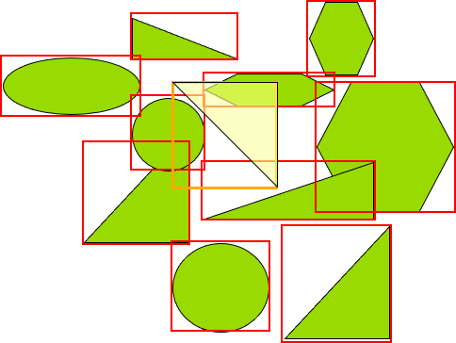
What green objects intersect the yellow query shape?
Section 15 - Spatial Indexing

Slide 83
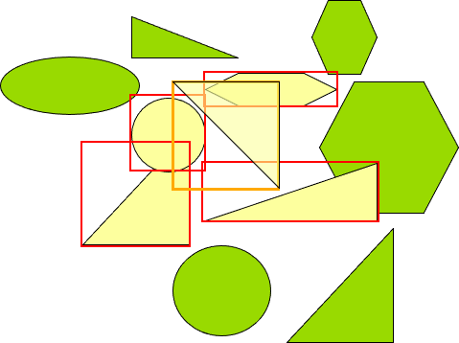
Use index to quickly finds the objects with bounding box intersection.
Section 15 - Spatial Indexing

Slide 84
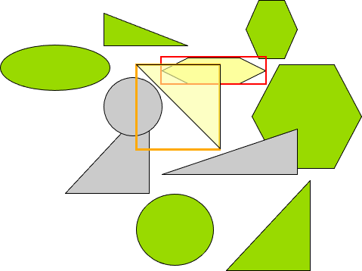
Exactly compute relationships in index result to find true intersection.
Section 15 - Spatial Indexing

Slide 85
Index-only queries
Section 15 - Spatial Indexing

Slide 86
Index-enabled Spatial Functions
Section 15 - Spatial Indexing
ST_Intersects()
ST_Contains()
ST_Within()
ST_DWithin()
ST_ContainsProperly()
ST_CoveredBy()
ST_Covers()
ST_Overlaps()
ST_Crosses()
ST_DFullyWithin()
ST_3DIntersects()
ST_3DDWithin()
ST_3DDFullyWithin()
ST_LineCrossingDirection()
ST_OrderingEquals()
ST_Equals()

Slide 87
Index-only queries
Section 15 - Spatial Indexing
geom_a && geom_b
The “&&” operator is the “bounding boxes overlap” operator.
It returns “true” when the bounds of the left and right arguments overlap.
Operators like “=” or “>” are symbols that express relationships between the left- and right-hand side arguments. “&&” is just another operator like any other.

Slide 88
What is the population of the West Village?
Section 15 - Spatial Indexing
SELECT Sum(blk.opn_total)
FROM nyc_neighborhoods nh
JOIN nyc_census_blocks blk
ON nh.geom && blk.geom
WHERE nh.name = 'West Village';
49821

Slide 89
What is the population of the West Village?
Section 15 - Spatial Indexing
SELECT Sum(blk.opn_total)
FROM nyc_neighborhoods nh
JOIN nyc_census_blocks blk
ON ST_Intersects(nh.geom, blk.geom)
WHERE nh.name = 'West Village';
26718

Slide 90
Section 16 - Projecting Data
Section 16 - Projecting Data

Slide 91
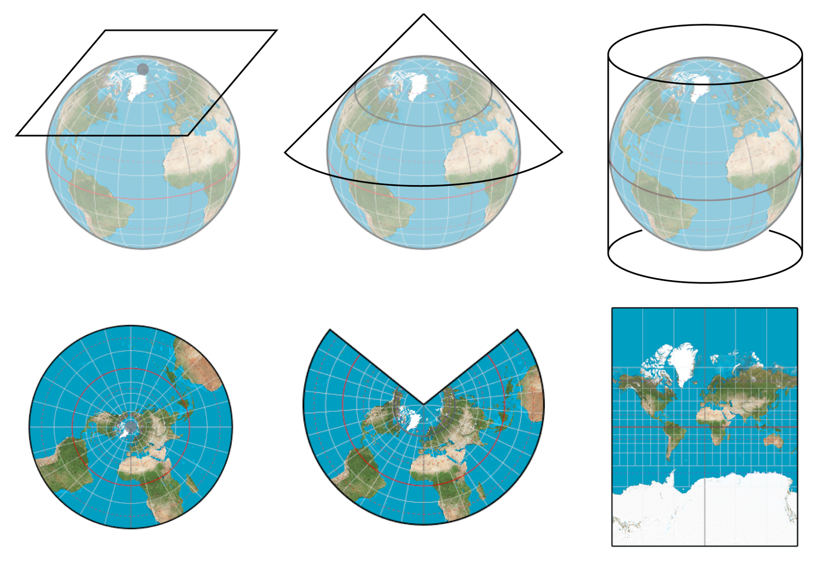
Section 16 - Projecting Data
The earth is not flat, and there is no simple way of putting it down on a flat paper map (or computer screen), so people have come up with all sorts of ingenious solutions, each with pros and cons.

Slide 92
Section 16 - Projecting Data
f(θ,Φ) → (x,y)
f ⁻¹(x,y) → (θ,Φ)
Forward projection converts spherical coordinates (longitude, latitude) to cartesian coordinates (x and y)
Inverse projection converts cartesian coordinates (x, y) to spherical coordinates (longitude, latitude)

Slide 93

Section 16 - Projecting Data

Slide 94
What is the SRID of our subways?
Section 16 - Projecting Data
SELECT ST_SRID(geom)
FROM nyc_subway_stations LIMIT 1;
26918

Slide 95
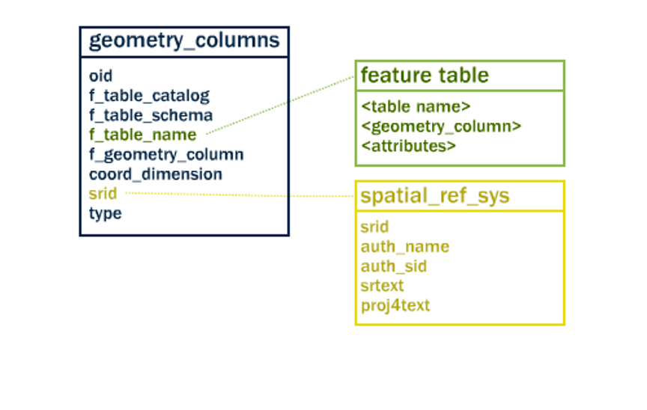
What does SRID 26918 mean though?
Section 16 - Projecting Data
SRID is a foreign key relating to spatial_ref_sys

Slide 96
What does SRID 26918 mean though?
Also, see: https://epsg.io/26918
Section 16 - Projecting Data
SELECT srtext
FROM spatial_ref_sys WHERE srid = 26918;

Slide 97
What does SRID 26918 mean though?
Section 16 - Projecting Data
PROJCS["NAD83 / UTM zone 18N",
GEOGCS["NAD83",
DATUM["North_American_Datum_1983",
SPHEROID["GRS 1980",6378137,298.257222101],
TOWGS84[0,0,0,0,0,0,0],
AUTHORITY["EPSG","6269"]],
PRIMEM["Greenwich",0],
UNIT["degree",0.0174532925199433],
AUTHORITY["EPSG","4269"]],
PROJECTION["Transverse_Mercator"],
PARAMETER["latitude_of_origin",0],
PARAMETER["central_meridian",-75],
PARAMETER["scale_factor",0.9996],
PARAMETER["false_easting",500000],
PARAMETER["false_northing",0],
UNIT["metre",1],
AXIS["Easting",EAST], AXIS["Northing",NORTH]]

Slide 98
What are coordinates of the “Broad St” subway station in geographic?
Section 16 - Projecting Data
SELECT
ST_AsText(ST_Transform(geom,4326))
FROM nyc_subway_stations
WHERE name = 'Broad St'; POINT(-74.0106714 40.7071048)

Slide 99
Section 18 - Geography
Section 18 - Geography

Slide 100
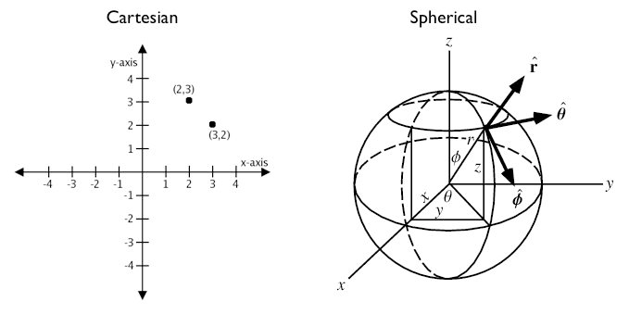
Geographic Coordinate Systems
Section 18 - Geography

Slide 101
What is the distance between Los Angeles and Paris using ST_Distance(geometry, geometry)?
Section 18 - Geography
SELECT ST_Distance( -- Los Angeles (LAX)
'SRID=4326;POINT(-118.4079 33.9434)'::geometry, -- Paris (CDG)
'SRID=4326;POINT(2.5559 49.0083)'::geometry
);
121.898285970107

Slide 102
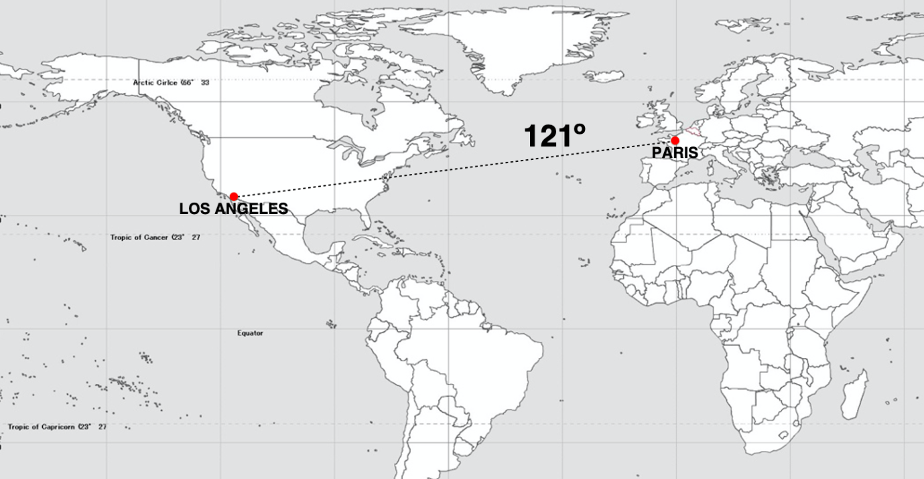
Section 18 - Geography

Slide 103
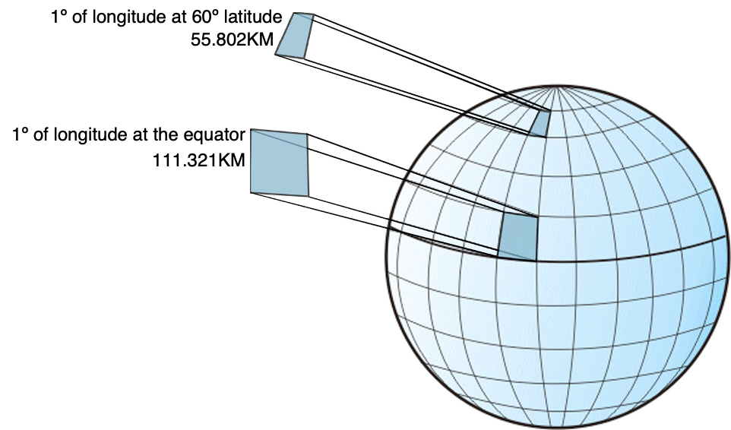
Degrees are not units of distance
Degrees are not units of area
Section 18 - Geography

Slide 104
What is the distance between Los Angeles and Paris using ST_Distance(geography, geography)?
Section 18 - Geography
SELECT ST_Distance( -- Los Angeles (LAX)
'SRID=4326;POINT(-118.4079 33.9434)'::geography, -- Paris (CDG)
'SRID=4326;POINT(2.5559 49.0083)'::geography
);
9124665.27317673

Slide 105
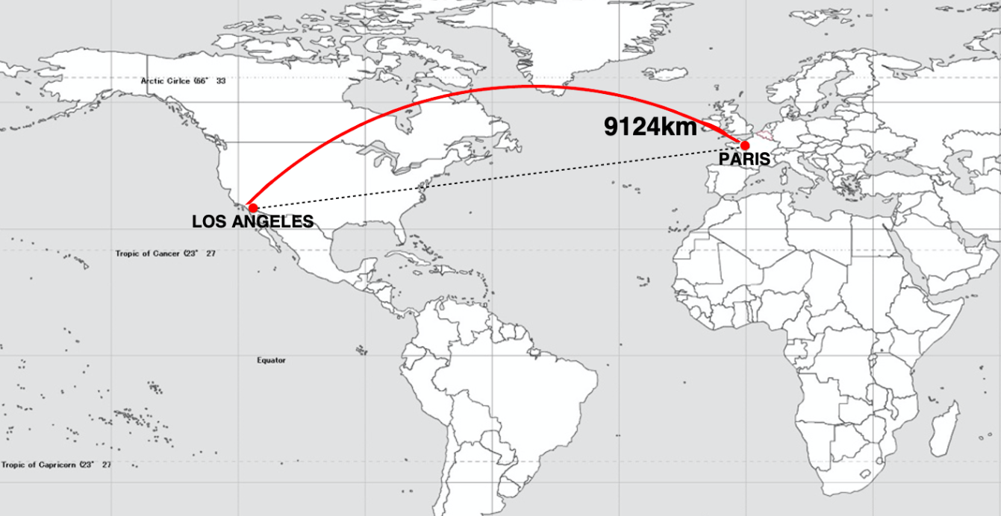
Section 18 - Geography

Slide 106
How close will a flight from Los Angeles to Paris come to Iceland?
Section 18 - Geography
SELECT ST_Distance(
-- LAX-CDG
'SRID=4326;LINESTRING( -118.4079 33.9434, 2.5559 49.0083)'::geography,
-- Iceland
'SRID=4326;POINT(-21.8628 64.1286)'::geography
);
531773.75711106

Slide 107
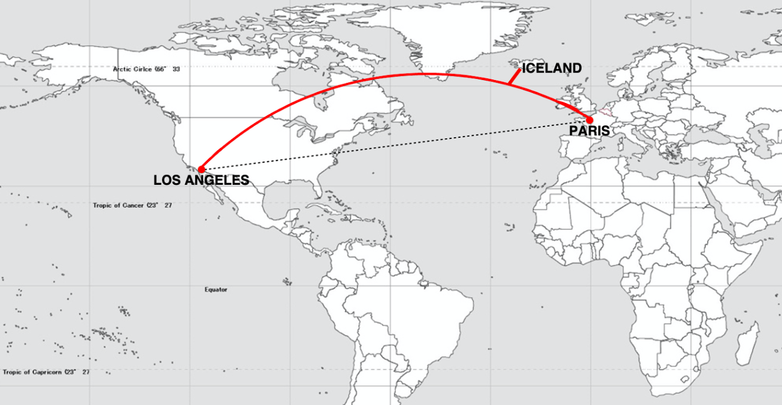
Section 18 - Geography

Slide 108
What is the shortest great-circle route from Los Angeles to Tokyo?
Section 18 - Geography
SELECT ST_Distance(
'SRID=4326;POINT(-118.408 33.943)'::geometry, -- LAX
'SRID=4326;POINT( 139.733 35.567)'::geometry) -- NRT
AS geometry_distance,
ST_Distance(
'POINT(-118.408 33.943)'::geography, -- LAX
'POINT( 139.733 35.567)'::geography) -- NRT
AS geography_distance;
geometry_distance: 258.14610835 geography_distance: 8833973.30246194

Slide 109
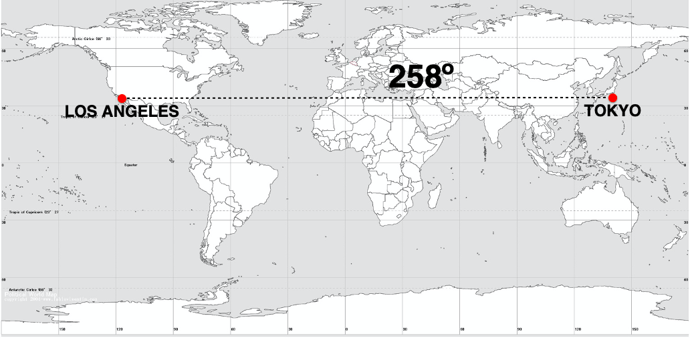
Geometry Distance
Section 18 - Geography

Slide 110
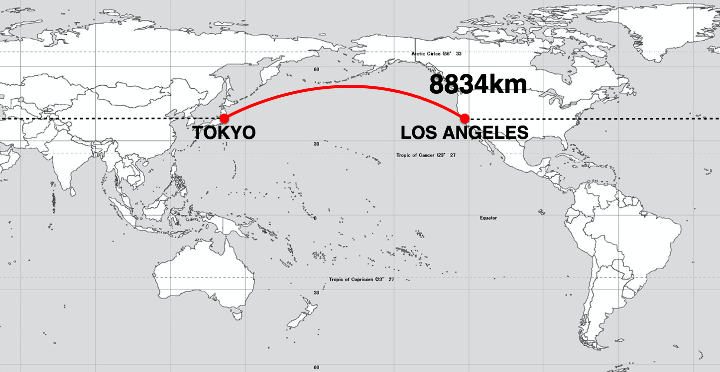
Geographic Distance
Section 18 - Geography

Slide 111
Using Geography - Casting
Section 18 - Geography
CREATE TABLE nyc_subway_stations_geog AS
SELECT
ST_Transform(geom, 4326)::geography AS geog,
name,
routes
FROM nyc_subway_stations;

Slide 112
Using Geography - Indexing
Section 18 - Geography
CREATE INDEX nyc_subway_stations_geog_gix
ON nyc_subway_stations_geog
USING GIST (geog);

Slide 113
Using Geography - Querying
Section 18 - Geography
WITH empire_state_building AS ( SELECT 'POINT(-73.98501 40.74812)'::geography AS geog
) SELECT name,
ST_Distance(esb.geog, ss.geog) AS distance,
degrees(ST_Azimuth(esb.geog, ss.geog)) AS direction
FROM nyc_subway_stations_geog ss,
empire_state_building esb
WHERE ST_DWithin(ss.geog, esb.geog, 500);

Slide 114
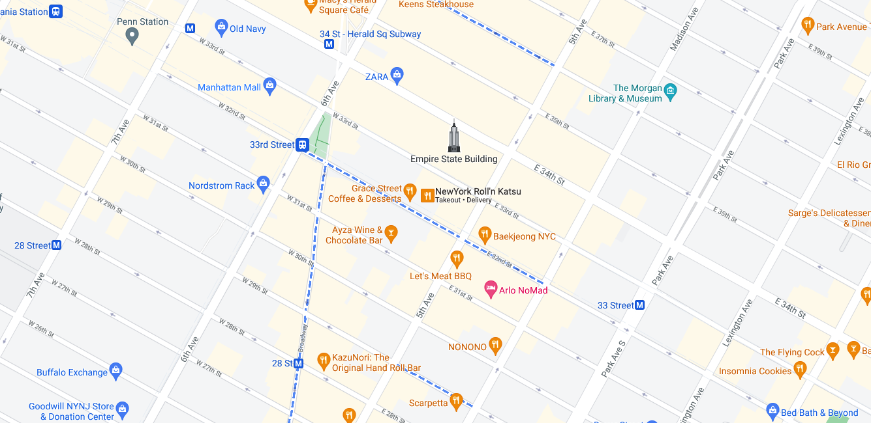
Section 18 - Geography
287m / 299°
328m / 125°
443m / 224°

Slide 115
Using Geography - From Scratch
Section 18 - Geography
CREATE TABLE airports (
code VARCHAR(3),
geog GEOGRAPHY(Point)
);
INSERT INTO airports VALUES ('LAX', 'POINT(-118.4079 33.9434)');
INSERT INTO airports VALUES ('CDG', 'POINT(2.5559 49.0083)');
INSERT INTO airports VALUES ('KEF', 'POINT(-22.6056 63.9850)');

Slide 116
Using Geography - From Scratch
Section 18 - Geography
SELECT * FROM geography_columns;
f_table_name | f_geography_column | srid | type
nyc_subway_stations_geog | geog | 0 | Geometry
airports | geog | 4326 | Point

Slide 117
Casting to Geometry
Section 18 - Geography
SELECT
code,
ST_X(geog::geometry) AS longitude
FROM airports;
The “::” syntax tells PostgreSQL to attempt to coerce the data into the new data type, if there is an available path.

Slide 118
Geography Native Functions
Section 18 - Geography
ST_Distance(G1, G2)
ST_DWithin(G1, G2, R)
ST_Area(geog)
ST_Length(geography)
ST_Covers(G1, G2)
ST_CoveredBy(G1, G2)
ST_Intersects(G1, G2)
ST_AsText(G1)
ST_AsBinary(G1)
ST_AsSVG(G1)
ST_AsGML(G1)
ST_AsKML(G1)
ST_AsGeoJson(G1)
ST_Buffer(G1, R)
ST_Intersection(G1, G2)

Slide 119

Geography is the Magic Solution?
Section 18 - Geography
The complexity of dealing with planar projections (choosing one, getting used to it) drives some users to fixate on the geography type as a simple cure-all.
However:
Not all functions in geography have native on-the-sphere implementations yet.
The computational cost of geography compared to geometry is quite high.

Slide 120
Section 18 - Geography
geography distance
geometry distance
double R = 6371000; /* meters */
double d_lat = lat2-lat1; /* radians */
double d_lon = lon2-lon1; /* radians */
double sin_lat = sin(d_lat/2);
double sin_lon = sin(d_lon/2);
double a = sin_lat * sin_lat +
cos(lat1) * cos(lat2) *
sin_lon * sin_lon;
double c = 2 * atan2(sqrt(a),
sqrt(1-a));
double d = R * c;
double dx = x2 - x1;
double dy = y2 - y1;
double d2 = dx * dx + dy * dy;
double d = sqrt(d2);
Notes:
Doing things on the sphere has a real computational cost. Point-to-point distance functions will be run millions of times when doing a spatial join between a couple medium sized spatial tables.
As you can imagine, the routine with one square root is faster than the one with two square roots and five trig functions.
Planar coordinates are what GIS systems used, and they are what the geometry type uses, and the geometry type was the first PostGIS type.
So there are hundreds of native geometry functions, and only a handful of native geography functions.
Long story short: if your data can be modelled on a plane, if it’s not truly global, you should use the geometry type and a planar projection, don’t use geography unless you have global data!

Slide 121
Section 20 - Geometry Constructing Functions
Section 20 - Geometry Constructing Functions

Slide 122
Functions so far...
Section 20 - Geometry Constructing Functions
Analysis
ST_Length(geometry) → float
ST_Area(geometry) → float
Conversion
ST_AsText(geometry) → text
ST_AsGML(geometry) → text
Retrieval
ST_RingN(geometry,n) → geometry
Comparison
ST_Contains(geometry,geometry) → boolean

Slide 123
Geometry constructing functions!
Section 20 - Geometry Constructing Functions
ST_Buffer(geometry) → geometry
ST_Centroid(geometry) → geometry
ST_Intersection(geometry, geometry) → geometry
ST_Union(geometry[]) → geometry
ST_Collect(geometry[]) → geometry

Slide 124
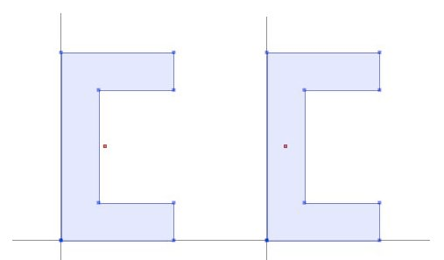
ST_Centroid
ST_PointOnSurface
Section 20 - Geometry Constructing Functions

Slide 125
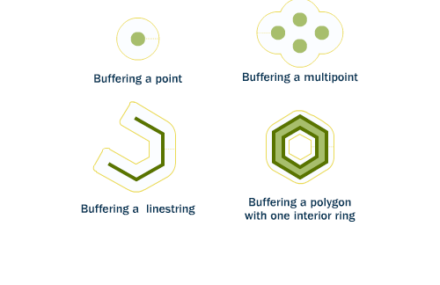
ST_Buffer
Section 20 - Geometry Constructing Functions

Slide 126
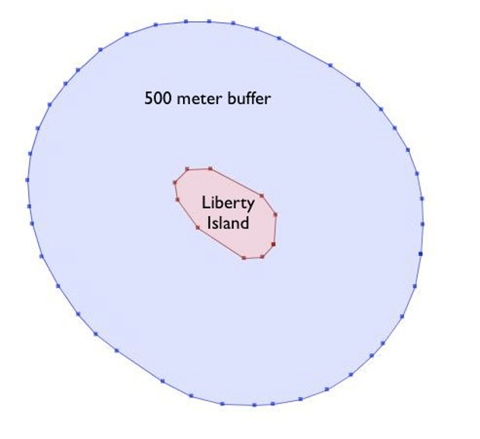
“What would a 500 meter marine traffic zone around Liberty Island look like?”
Section 20 - Geometry Constructing Functions

Slide 127
“What would a 500 meter marine traffic zone around Liberty Island look like?”
Section 20 - Geometry Constructing Functions
-- New table with a Liberty Island
-- 500m buffer zone
CREATE TABLE liberty_island_zone AS
SELECT
ST_Buffer(geom, 500)::Geometry(Polygon,26918) AS geom
FROM nyc_census_blocks
WHERE blkid = '360610001001001';

Slide 128
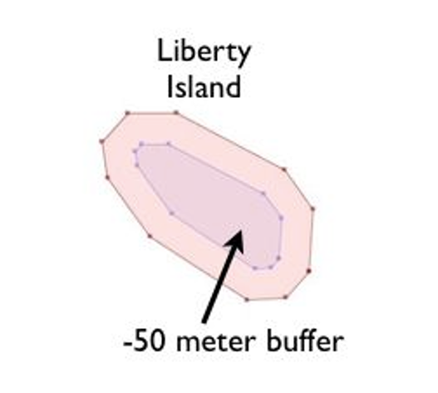
“What would a negative 50 meter marine traffic zone around Liberty Island look like?”
Section 20 - Geometry Constructing Functions

Slide 129
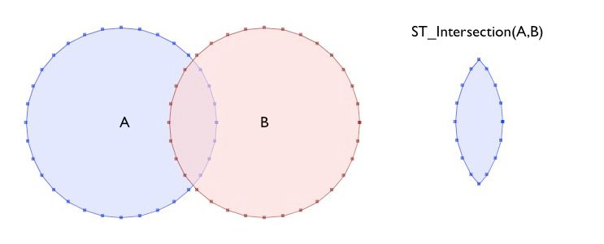
ST_Intersection(A, B)
Section 20 - Geometry Constructing Functions

Slide 130
“What is the area these two circles have in common?”
Section 20 - Geometry Constructing Functions
SELECT ST_AsText(ST_Intersection(
ST_Buffer('POINT(0 0)', 2),
ST_Buffer('POINT(3 0)', 2)
));

Slide 131
“What is the area these two circles have in common?”
Section 20 - Geometry Constructing Functions
POLYGON((
2 0,
1.96157056080646 -0.390180644032256,
1.84775906502257 -0.765366864730179,
1.66293922460509 -1.1111404660392,
1.5 -1.30968248567708,
1.33706077539491 -1.11114046603921,
1.15224093497743 -0.765366864730185,
1.03842943919354 -0.390180644032262,
1 -6.46217829773035e-15,
1.03842943919354 0.39018064403225,
1.15224093497742 0.765366864730173,
1.33706077539491 1.1111404660392,
1.5 1.30968248567708,
1.66293922460509 1.11114046603921,
1.84775906502257 0.765366864730184,
1.96157056080646 0.390180644032261,
2 0))

Slide 132
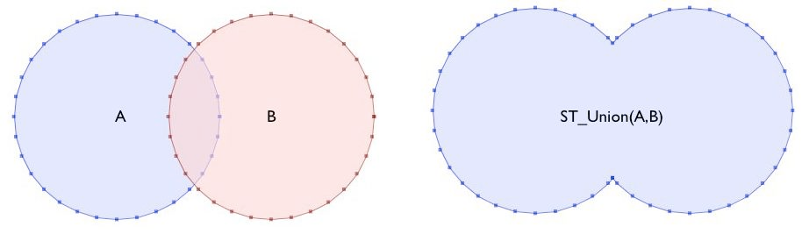
ST_Union(A, B)
Section 20 - Geometry Constructing Functions

Slide 133
Terminology
Forms
Section 20 - Geometry Constructing Functions
Esri “dissolve” == PostGIS “union”
Melt together small things into larger things.
Esri “union” == PostGIS “overlay”
Cookie cut larger things into smaller things.
ST_Union(geom1, geom2)
Melt together two geometries.
ST_Union(geometry[])
Melt together a set of geometries. “Aggregate” function like Sum() or Average(). Use with GROUP BY.

Slide 134
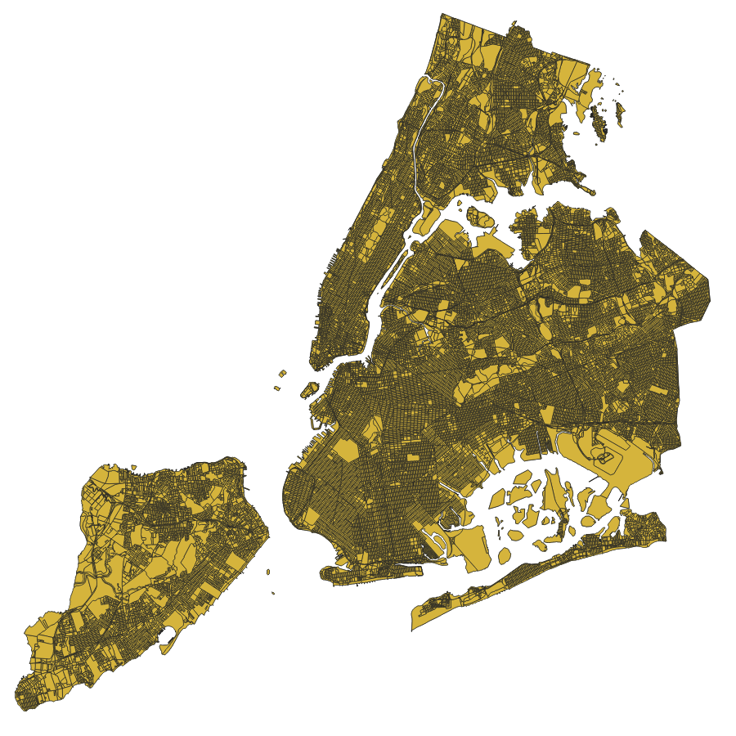
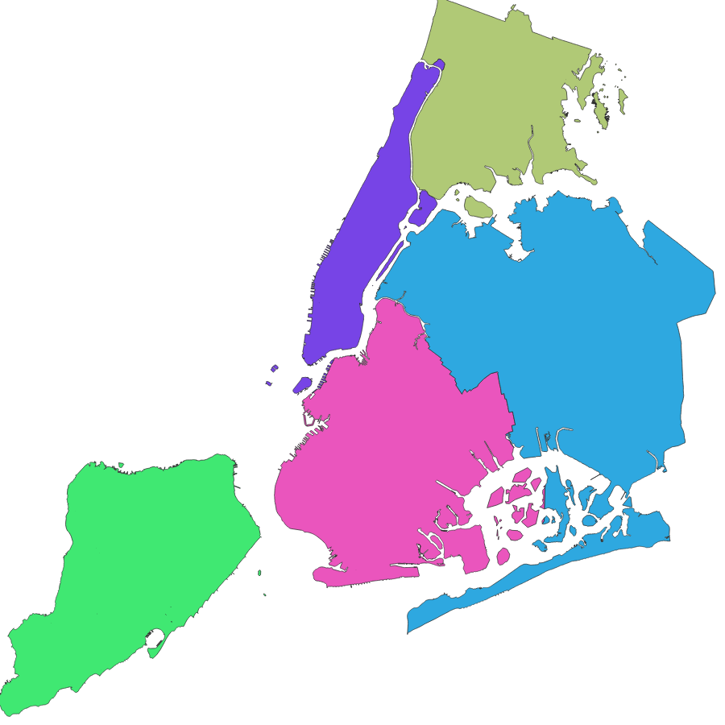
“How would you make a county map from census blocks?”
Section 20 - Geometry Constructing Functions

Slide 135
Census Block ID
Section 20 - Geometry Constructing Functions
US Census Block IDs encode the geographic hierarchy used by the census.
360610001001001 = 36 061 000100 1 001
36 = State of New York
061 = New York County (Manhattan)
000100 = Census Tract
1 = Census Block Group
001 = Census Block
Notes:
The unique key blkid actually embeds information about the higher level geographies.
Here are the parts of the key for Liberty Island we used earlier:

Slide 136
“How would you make a county map from
census blocks?”
Section 20 - Geometry Constructing Functions
-- An nyc_census_counties table -- by merging census blocks
CREATE TABLE nyc_census_counties AS
SELECT
ST_Union(geom) AS geom,
SubStr(blkid,1,5) AS countyid
FROM nyc_census_blocks
GROUP BY countyid;

Slide 137
Section 22 - More Spatial Joins!
Section 22 - More Spatial Joins

Slide 138

Load the nyc_census_sociodata.sql table
Section 22 - More Spatial Joins
Open the Query Tool in pgAdmin
Select Open File
Browse to the nyc_census_sociodata.sql file
Run query
-- 2167 SELECT
Count(*)
FROM nyc_census_sociodata;
Notes:
*double check pgAdmin 4

Slide 139
Section 22 - More Spatial Joins
How would you make a census tract map from census blocks?
Notes:
(define tract)
Census geography is carefully constructed so that larger geographies can be built up from smaller ones.
Create a census tracts map by merging the blocks that form each tract
Create a county map by merging blocks that fall within each county.

Slide 140
Recall...
Section 22 - More Spatial Joins
Liberty Island blkid
360610001001001 = 36 061 000100 1 001
36 = State of New York
061 = New York County (Manhattan)
000100 = Census Tract
1 = Census Block Group
001 = Census Block
Notes:
The unique key blkid actually embeds information about the higher level geographies.
Here are the parts of the key for Liberty Island we used earlier:

Slide 141
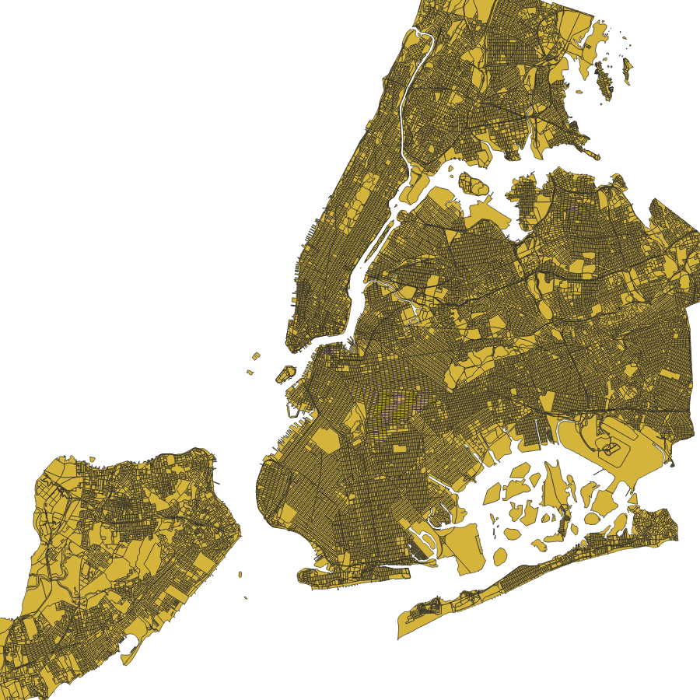
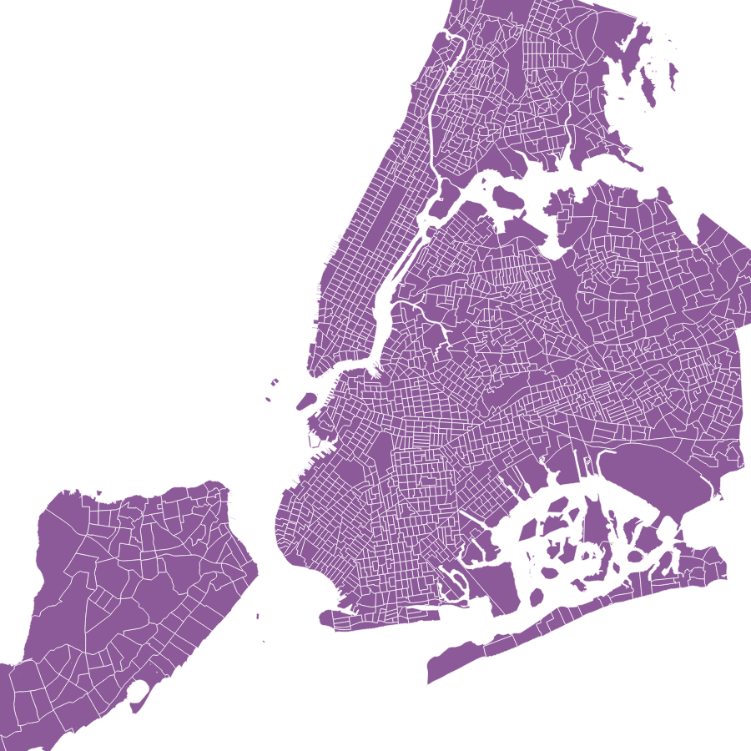
Section 22 - More Spatial Joins
Blocks
Tracts

Slide 142
ST_Union() Blocks into Tracts
Section 22 - More Spatial Joins
-- Make the tracts table
CREATE TABLE nyc_census_tract_geoms AS
SELECT
ST_Union(geom) AS geom,
substr(blkid,1,11) AS tractid
FROM nyc_census_blocks
GROUP BY tractid;
-- Index the tractid
CREATE INDEX nyc_census_tract_geoms_tractid_idx
ON nyc_census_tract_geoms (tractid);

Slide 143
Section 22 - More Spatial Joins
How can you associate census data with your census tract map?

Slide 144
ST_Union() Blocks into Tracts
Section 22 - More Spatial Joins
-- Make the tracts table
CREATE TABLE nyc_census_tracts AS
SELECT g.geom, a.*
FROM nyc_census_tract_geoms g
JOIN nyc_census_sociodata a
ON g.tractid = a.tractid;
-- Index the geometries
CREATE INDEX nyc_census_tract_gidx ON nyc_census_tracts USING GIST (geom);

Slide 145
Section 22 - More Spatial Joins
“List top 10 New York neighborhoods ordered by the proportion of people who have graduate degrees?”

Slide 146
Graduate Degree Population %
Section 22 - More Spatial Joins
SELECT
100.0 * Sum(t.edu_graduate_dipl) /
Sum(t.edu_total) AS graduate_pct,
n.name, n.boroname
FROM nyc_neighborhoods n
JOIN nyc_census_tracts t
ON ST_Intersects(n.geom, t.geom)
WHERE t.edu_total > 0
GROUP BY n.name, n.boroname
ORDER BY graduate_pct DESC
LIMIT 10;

Slide 147
Graduate Degree Population %
Section 22 - More Spatial Joins
graduate_pct | name | boroname
---------------------+-------------------+-----------
47.6469321851453175 | Carnegie Hill | Manhattan
42.1632365492235696 | Upper West Side | Manhattan
41.0656645950763598 | Battery Park | Manhattan
39.5611557679774060 | Flatbush | Brooklyn
39.3409549428379287 | Tribeca | Manhattan
39.2188240872451399 | North Sutton Area | Manhattan
38.6922550118291620 | Greenwich Village | Manhattan
38.6054942073575506 | Upper East Side | Manhattan
37.8834795573140662 | Murray Hill | Manhattan
37.3714416181491744 | Central Park | Manhattan

Slide 148
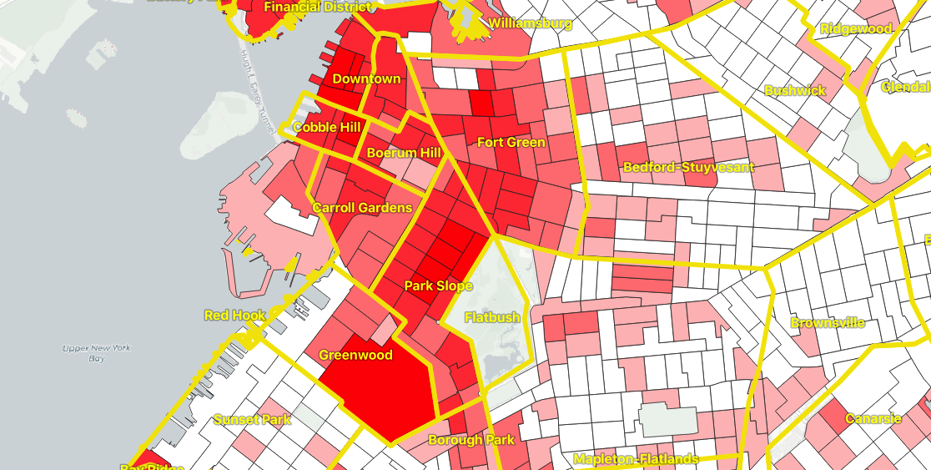

Slide 149
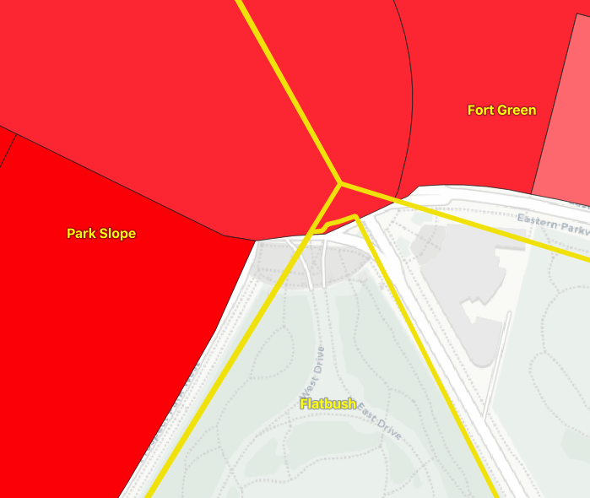
The otherwise-empty “Flatbush” neighborhood polygon (which mostly covers Prospect Park) just grazes one high-education tract polygon, resulting in a spurious high measurement for the neighborhood.

Slide 150
Section 22 - More Spatial Joins
What if a tract falls on the border between two neighborhoods?
Notes:
(remember to define tract)
It will intersect both, and so will be included in the summary statistics for both.

Slide 151
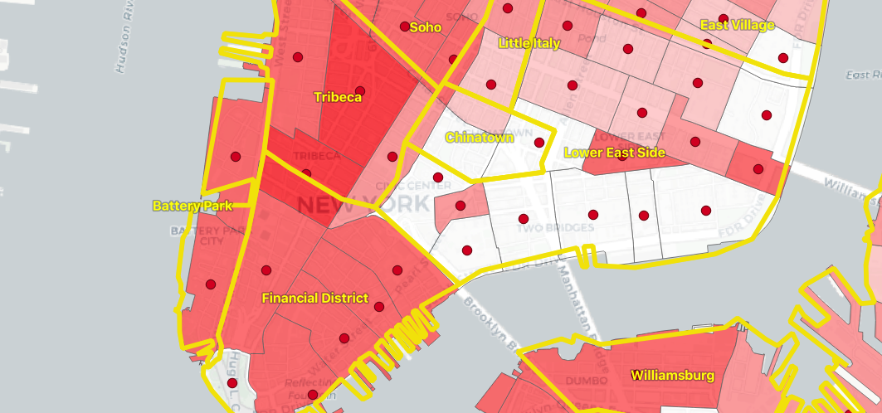
Centroid as proxy for polygons
Section 22 - More Spatial Joins
Notes:
It will intersect both, and so will be included in the summary statistics for both.
Avoid this kind of double counting:
The simple method is to ensure that each tract only falls in one summary area (using ST_Centroid(geometry))
The complex method is to divide crossing tracts at the borders (using ST_Intersection(geometry,geometry))

Slide 152
Join on ST_Centroid
Section 22 - More Spatial Joins
SELECT
100.0 * Sum(t.edu_graduate_dipl) / Sum(t.edu_total) AS graduate_pct,
n.name,
n.boroname
FROM nyc_neighborhoods n
JOIN nyc_census_tracts t
ON ST_Contains(n.geom, ST_Centroid(t.geom))
WHERE t.edu_total > 0
GROUP BY n.name, n.boroname
ORDER BY graduate_pct DESC
LIMIT 10;
Notes:
Note that the query takes longer to run now, because the ST_Centroid function has to be run on every census tract.

Slide 153
Join on intersects vs centroid
ST_Intersects()
ST_Centroid()
Section 22 - More Spatial Joins
graduate_pct | name | boroname
--------------+---------------------+-----------
47.6 | Carnegie Hill | Manhattan
42.2 | Upper West Side | Manhattan
41.1 | Battery Park | Manhattan
39.6 | Flatbush | Brooklyn
39.3 | Tribeca | Manhattan
39.2 | North Sutton Area | Manhattan
38.7 | Greenwich Village | Manhattan
38.6 | Upper East Side | Manhattan
37.9 | Murray Hill | Manhattan
37.4 | Central Park | Manhattan
graduate_pct | name | boroname
--------------+---------------------+-----------
48.0 | Carnegie Hill | Manhattan
44.2 | Morningside Heights | Manhattan
42.1 | Greenwich Village | Manhattan
42.0 | Upper West Side | Manhattan
41.4 | Tribeca | Manhattan
40.7 | Battery Park | Manhattan
39.5 | Upper East Side | Manhattan
39.3 | North Sutton Area | Manhattan
37.4 | Cobble Hill | Brooklyn
37.4 | Murray Hill | Manhattan
Notes:
Note that the query takes longer to run now, because the ST_Centroid function has to be run on every census tract.

Slide 154
Section 22 - More Spatial Joins
How many people live within 500m of a subway station?
Notes:
It will intersect both, and so will be included in the summary statistics for both.

Slide 155
ST_Centroid
Section 22 - More Spatial Joins
How many people in New York?
SELECT
Sum(popn_total)
FROM nyc_census_blocks;
Notes:
Note that the query takes longer to run now, because the ST_Centroid function has to be run on every census tract.

Slide 156
ST_Centroid
Section 22 - More Spatial Joins
How many people 500m from a subway station?
SELECT
Sum(popn_total)
FROM nyc_census_blocks census
JOIN nyc_subway_stations subway
ON ST_DWithin(
census.geom,
subway.geom,
500
);
Notes:
Note that the query takes longer to run now, because the ST_Centroid function has to be run on every census tract.

Slide 157
ST_Centroid
Section 22 - More Spatial Joins
How many people in New York?
8,175,032
How many people 500m from a subway station?
10,855,873 ?!?!!?
Notes:
Note that the query takes longer to run now, because the ST_Centroid function has to be run on every census tract.

Slide 158
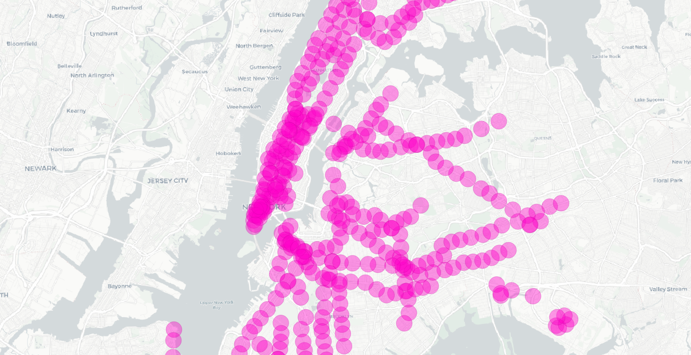
Overlapping query areas
Section 22 - More Spatial Joins

Slide 159
Overlapping query areas
Section 22 - More Spatial Joins
How many people 500m from a subway station?
WITH distinct_blocks AS (
SELECT DISTINCT ON (blkid) popn_total
FROM nyc_census_blocks census
JOIN nyc_subway_stations subway
ON ST_DWithin(
census.geom,
subway.geom,
500)
)
SELECT Sum(popn_total)
FROM distinct_blocks;
Notes:
Note that the query takes longer to run now, because the ST_Centroid function has to be run on every census tract.

Slide 160
Section 23 - Validity
Section 23 - Validity

Slide 161

POLYGON((0 0, 0 1, 2 1, 2 2, 1 2, 1 0, 0 0))
Section 23 - Validity

Slide 162

Why does validity matter?
Section 23 - Validity
Geometry algorithms rely on properties enforced by validity: ring orientation, self-crossing, self-touching. All can confuse different algorithms.
-1
SELECT ST_Area(ST_GeomFromText(
'POLYGON((0 0, 0 1, 1 1, 2 1, 2 2, 1 2, 1 1, 1 0, 0 0))'
));
0
1

Slide 163
Can we test validity?
Section 23 - Validity
Self-intersection[1 1]
ST_IsValid() returns a boolean for validity, and ST_IsValidReason() returns a coordinate of where the error is, and a textual reason.
SELECT ST_IsValid(ST_GeomFromText(
'POLYGON((0 0, 0 1, 1 1, 2 1, 2 2, 1 2, 1 1, 1 0, 0 0))'
));
false

Slide 164
Can we test validity in bulk?
Section 23 - Validity
SELECT name, boroname,
ST_IsValidReason(geom)
FROM nyc_neighborhoods
WHERE NOT ST_IsValid(geom); Howard Beach | Queens | Self-intersection[596394 4500899]
Corona | Queens | Self-intersection[595483 4513817]
Red Hook | Brooklyn | Self-intersection[582655 4500908]
Steinway | Queens | Self-intersection[593198 4515125]

Slide 165
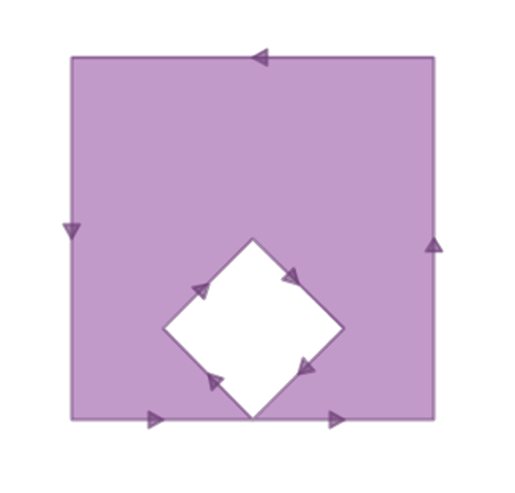
Can we fix validity in bulk?
Section 23 - Validity
The “banana polygon” is a polygon with a hole, formed by a ring that touches itself at a single point.
SELECT ST_AsText(ST_MakeValid( 'POLYGON((0 0, 2 0, 1 1, 2 2, 3 1, 2 0, 4 0, 4 4, 0 4, 0 0))'))
ST_MakeValid() juggles the components of an invalid polygon to form a “best guess” valid interpretation of the rings. The “banana polygon” gets turns into a traditional exterior/interior ring polygon.
POLYGON((0 0,0 4,4 4,4 0,2 0,0 0),(3 1,2 2,1 1,2 0,3 1))

Slide 166
Can we fix validity in bulk?
ST_MakeValid(geom, options)
Section 23 - Validity
UPDATE nyc_neighborhoods SET geom = ST_MakeValid(geom)
WHERE NOT ST_IsValid(geom);
PostGIS 3.2+ includes text options to change the repair algorithm.
'method=linework'
'method=structure keepcollapsed=false'

Slide 167
Section 24 - Equality
Section 24 - Equality

Slide 168
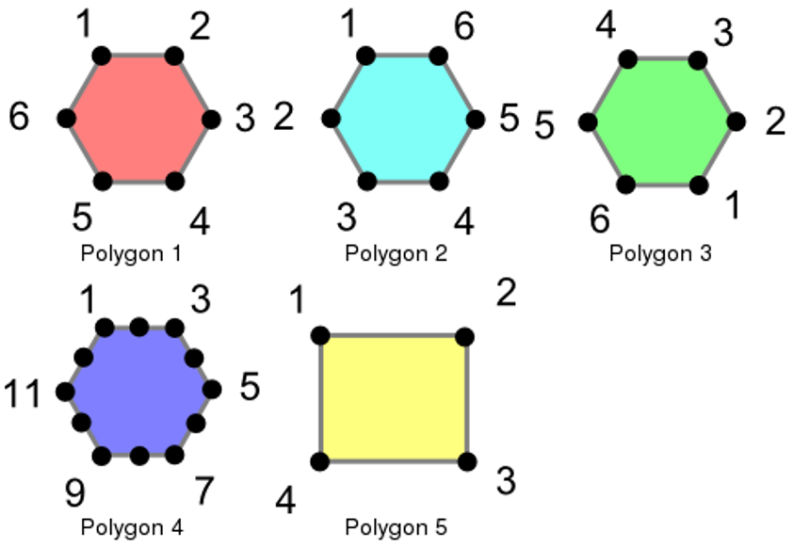
Section 24 - Equality

Slide 169
Create the test polygons
CREATE TABLE polygons (id integer, name varchar, poly geometry);
INSERT INTO polygons VALUES
(1, 'Polygon 1', 'POLYGON((-1 1.732,1 1.732,2 0,1 -1.732,
-1 -1.732,-2 0,-1 1.732))'),
(2, 'Polygon 2', 'POLYGON((-1 1.732,-2 0,-1 -1.732,1 -1.732,
2 0,1 1.732,-1 1.732))'),
(3, 'Polygon 3', 'POLYGON((1 -1.732,2 0,1 1.732,-1 1.732,
-2 0,-1 -1.732,1 -1.732))'),
(4, 'Polygon 4', 'POLYGON((-1 1.732,0 1.732, 1 1.732,1.5 0.866,
2 0,1.5 -0.866,1 -1.732,0 -1.732,-1 -1.732,-1.5 -0.866,
-2 0,-1.5 0.866,-1 1.732))'),
(5, 'Polygon 5', 'POLYGON((-2 -1.732,2 -1.732,2 1.732,
-2 1.732,-2 -1.732))');
Section 24 - Equality

Slide 170
Ways of testing equality!
Section 24 - Equality
ST_OrderingEquals(A, B)
ST_Equals(A, B)
A = B
A ~= B

Slide 171
Section 24 - Equality
SELECT a.name, b.name, CASE WHEN ST_OrderingEquals(a.poly, b.poly) THEN 'Exactly Equal' ELSE 'Not Exactly Equal' END
FROM polygons AS a, polygons AS b;
Polygon 1 | Polygon 1 | Exactly Equal
Polygon 1 | Polygon 2 | Not Exactly Equal
Polygon 1 | Polygon 3 | Not Exactly Equal
Polygon 1 | Polygon 4 | Not Exactly Equal
Polygon 1 | Polygon 5 | Not Exactly Equal
Polygon 2 | Polygon 1 | Not Exactly Equal
Polygon 2 | Polygon 2 | Exactly Equal
Polygon 2 | Polygon 3 | Not Exactly Equal
Polygon 2 | Polygon 4 | Not Exactly Equal
Polygon 2 | Polygon 5 | Not Exactly Equal
Polygon 3 | Polygon 1 | Not Exactly Equal
Polygon 3 | Polygon 2 | Not Exactly Equal
Polygon 3 | Polygon 3 | Exactly Equal
Polygon 3 | Polygon 4 | Not Exactly Equal
Polygon 3 | Polygon 5 | Not Exactly Equal
Polygon 4 | Polygon 1 | Not Exactly Equal
Polygon 4 | Polygon 2 | Not Exactly Equal
Polygon 4 | Polygon 3 | Not Exactly Equal
Polygon 4 | Polygon 4 | Exactly Equal
Polygon 4 | Polygon 5 | Not Exactly Equal
Polygon 5 | Polygon 1 | Not Exactly Equal
Polygon 5 | Polygon 2 | Not Exactly Equal
Polygon 5 | Polygon 3 | Not Exactly Equal
Polygon 5 | Polygon 4 | Not Exactly Equal
Polygon 5 | Polygon 5 | Exactly Equal

Slide 172
Section 24 - Equality
SELECT a.name, b.name, CASE WHEN ST_Equals(a.poly, b.poly) THEN 'Spatially Equal' ELSE 'Not Equal' END
FROM polygons AS a, polygons AS b;
Polygon 1 | Polygon 1 | Spatially Equal
Polygon 1 | Polygon 2 | Spatially Equal
Polygon 1 | Polygon 3 | Spatially Equal
Polygon 1 | Polygon 4 | Spatially Equal
Polygon 1 | Polygon 5 | Not Equal
Polygon 2 | Polygon 1 | Spatially Equal
Polygon 2 | Polygon 2 | Spatially Equal
Polygon 2 | Polygon 3 | Spatially Equal
Polygon 2 | Polygon 4 | Spatially Equal
Polygon 2 | Polygon 5 | Not Equal
Polygon 3 | Polygon 1 | Spatially Equal
Polygon 3 | Polygon 2 | Spatially Equal
Polygon 3 | Polygon 3 | Spatially Equal
Polygon 3 | Polygon 4 | Spatially Equal
Polygon 3 | Polygon 5 | Not Equal
Polygon 4 | Polygon 1 | Spatially Equal
Polygon 4 | Polygon 2 | Spatially Equal
Polygon 4 | Polygon 3 | Spatially Equal
Polygon 4 | Polygon 4 | Spatially Equal
Polygon 4 | Polygon 5 | Not Equal
Polygon 5 | Polygon 1 | Not Equal
Polygon 5 | Polygon 2 | Not Equal
Polygon 5 | Polygon 3 | Not Equal
Polygon 5 | Polygon 4 | Not Equal
Polygon 5 | Polygon 5 | Spatially Equal

Slide 173
Section 24 - Equality
SELECT a.name, b.name, CASE WHEN a.poly = b.poly THEN 'Spatially =' ELSE 'Not =' END
FROM polygons AS a, polygons AS b;
Polygon 1 | Polygon 1 | Spatially =
Polygon 1 | Polygon 2 | Not =
Polygon 1 | Polygon 3 | Not =
Polygon 1 | Polygon 4 | Not =
Polygon 1 | Polygon 5 | Not =
Polygon 2 | Polygon 1 | Not =
Polygon 2 | Polygon 2 | Spatially =
Polygon 2 | Polygon 3 | Not =
Polygon 2 | Polygon 4 | Not =
Polygon 2 | Polygon 5 | Not =
Polygon 3 | Polygon 1 | Not =
Polygon 3 | Polygon 2 | Not =
Polygon 3 | Polygon 3 | Spatially =
Polygon 3 | Polygon 4 | Not =
Polygon 3 | Polygon 5 | Not =
Polygon 4 | Polygon 1 | Not =
Polygon 4 | Polygon 2 | Not =
Polygon 4 | Polygon 3 | Not =
Polygon 4 | Polygon 4 | Spatially =
Polygon 4 | Polygon 5 | Not =
Polygon 5 | Polygon 1 | Not =
Polygon 5 | Polygon 2 | Not =
Polygon 5 | Polygon 3 | Not =
Polygon 5 | Polygon 4 | Not =
Polygon 5 | Polygon 5 | Spatially =

Slide 174
Section 24 - Equality
SELECT a.name, b.name, CASE WHEN a.poly ~= b.poly THEN 'Bounds Equal' ELSE 'Bounds Not Equal' END
FROM polygons AS a, polygons AS b;
Polygon 1 | Polygon 1 | Bounds Equal
Polygon 1 | Polygon 2 | Bounds Equal
Polygon 1 | Polygon 3 | Bounds Equal
Polygon 1 | Polygon 4 | Bounds Equal
Polygon 1 | Polygon 5 | Bounds Equal
Polygon 2 | Polygon 1 | Bounds Equal
Polygon 2 | Polygon 2 | Bounds Equal
Polygon 2 | Polygon 3 | Bounds Equal
Polygon 2 | Polygon 4 | Bounds Equal
Polygon 2 | Polygon 5 | Bounds Equal
Polygon 3 | Polygon 1 | Bounds Equal
Polygon 3 | Polygon 2 | Bounds Equal
Polygon 3 | Polygon 3 | Bounds Equal
Polygon 3 | Polygon 4 | Bounds Equal
Polygon 3 | Polygon 5 | Bounds Equal
Polygon 4 | Polygon 1 | Bounds Equal
Polygon 4 | Polygon 2 | Bounds Equal
Polygon 4 | Polygon 3 | Bounds Equal
Polygon 4 | Polygon 4 | Bounds Equal
Polygon 4 | Polygon 5 | Bounds Equal
Polygon 5 | Polygon 1 | Bounds Equal
Polygon 5 | Polygon 2 | Bounds Equal
Polygon 5 | Polygon 3 | Bounds Equal
Polygon 5 | Polygon 4 | Bounds Equal
Polygon 5 | Polygon 5 | Bounds Equal

Slide 175
Section 25 - Linear Referencing
Section 25 - Linear Referencing

Slide 176



Section 25 - Linear Referencing
“B is 40% of the way along A”

Slide 177
Section 25 - Linear Referencing
hyw | brdg | loc
12 | 101 | 10.5
hyw | geom
12
“The bridge is at mile 10.5 on Highway 12”

Slide 178

Section 25 - Linear Referencing
rvr | fsh | from | to
9 | 101 | 3 | 5
hyw | geom
9
“The salmon habitat is from 3km to 5km above the confluence”

Slide 179
Section 25 - Linear Referencing
SELECT ST_LineLocatePoint( 'LINESTRING(0 0,2 2)', 'POINT(0.9 1.1)' );
0.5

Slide 180
Section 25 - Linear Referencing
SELECT ST_AsText( ST_LineInterpolatePoint( 'LINESTRING(0 0,2 2)', 0.5 ));
POINT(1, 1)

Slide 181

Section 25 - Linear Referencing

Slide 182
Find nearest street to each subway station
WITH ordered_nearest AS (
SELECT
ST_GeometryN(str.geom,1) AS streets_geom,
str.gid AS str_gid,
sub.geom AS subways_geom,
sub.gid AS subways_gid,
ST_Distance(str.geom, sub.geom) AS distance
FROM nyc_streets str
JOIN nyc_subway_stations sub
ON ST_DWithin(str.geom, sub.geom, 200)
ORDER BY subways_gid, distance ASC
)
Section 25 - Linear Referencing

Slide 183
Find measure of station on nearest street
SELECT
DISTINCT ON (subways_gid)
subways_gid,
streets_gid,
distance, ST_LineLocatePoint(
streets_geom,
subways_geom) AS measure
FROM ordered_nearest;
Section 25 - Linear Referencing

Slide 184
Find measure of station on nearest street
subways_gid | streets_gid | measure
-------------+-------------+------------------------
1 | 17404 | 0.0023154983819572554
2 | 17318 | 0.6354078182846773
3 | 19086 | 0.24946227178552738
4 | 1924 | 0.11187222763997673
5 | 2067 | 0.9261874246426975
6 | 1934 | 0.33457647816803476
7 | 2024 | 0.5549461001845787
8 | 2469 | 0.2296616075093935
9 | 2024 | 0.9069811058590412
10 | 2067 | 0.6202998183141508
Section 25 - Linear Referencing

Slide 185
How to visualize events? Turn them back into points.
Section 25 - Linear Referencing
-- New view that turns events back
-- into spatial objects
CREATE OR REPLACE VIEW nyc_subway_stations_lrs AS
SELECT
events.subways_gid,
ST_LineInterpolatePoint( ST_GeometryN(streets.geom, 1),
events.measure) AS geom,
events.streets_gid
FROM nyc_subway_station_events events
JOIN nyc_streets streets
ON (streets.gid = events.streets_gid);

Slide 186

Section 25 - Linear Referencing
Original subway stations (orange stars) on Columbus Circle have been snapped over to the nearby roadways in the LRS view (blue circles)
Shows how LRS functions can be used to snap points to a network, as well as to manage actual LRS data.

Slide 187
Section 29 - Nearest Neighbor Searching
Section 29 - Nearest Neighbor Searching

Slide 188
Nearest Neighbor Search
Nearest Neighbor Join
Section 29 - Nearest Neighbor Searching
“What is the nearest fire station to this address?”
“What are the 10 nearest gas stations to the current locations?”
“Add the nearest fire station to every parcel in the table.”

Slide 189
Nearest Neighbor Search
-- The location of Broad St station
-- SRID=26918;POINT(583571.9 4506714.3)
SELECT streets.gid, streets.name,
ST_Distance(streets.geom, 'SRID=26918;POINT(583571.9 4506714.3)') AS dist
FROM nyc_streets streets
ORDER BY
streets.geom <-> 'SRID=26918;POINT(583571.9 4506714.3)'::geometry
LIMIT 3;
Section 29 - Nearest Neighbor Searching
no WHERE clause
ORDER BY distance
LIMIT clause

Slide 190

Section 29 - Nearest Neighbor Searching
gid | name | dist
-------+-----------+--------------------
17385 | Wall St | 0.749987508809928
17390 | Broad St | 0.8836306235191059
17436 | Nassau St | 1.336828024107041

Slide 191
Nearest Neighbor Join
SELECT subways.gid AS subway_gid,
subways.name AS subway,
streets.name AS street,
streets.gid AS street_gid
FROM nyc_subway_stations subways
CROSS JOIN LATERAL (
SELECT streets.name, streets.geom, streets.gid
FROM nyc_streets streets
ORDER BY streets.geom <-> subways.geom
LIMIT 1
) streets;
Section 29 - Nearest Neighbor Searching
LATERAL join
outer parameter
LIMIT clause
ORDER BY distance

Slide 192

Section 29 - Nearest Neighbor Searching

